Slide 1
Shelter Photo Guidelines

Slide 2
CHILD PROTECTION POLICY

Slide 3
General Guidelines for Volunteers
Notes:
Break it up .Volunteers are strictly advised against sharing personal pictures on social media or any public platforms.

Slide 4
Photos and videos can be taken only by trained MAD Volunteers after permission from the Shelter Authorities.
Notes:
Break it up .Volunteers are strictly advised against sharing personal pictures on social media or any public platforms.

Slide 5
No pictures or videos should be taken by volunteers on their personal phones and cameras

Slide 6
Photos taken may be shared only internally with volunteers depending on whether we have trained photographers available in the city and approved nationally.

Slide 7
Guidelines for Photographers

Slide 8
Photographs can be taken only after prior approval of the Shelter Authority.

Slide 9
Pictures of children in compromising positions should not be clicked.
Notes:
This includes not taking pictures of children during the pool session or in their rooms.

Slide 10
Photographs should contain more than one child in the frame.
Notes:
No photos of only one child or only one volunteer and child in the frame as this is a violation of the Juvenile Justice Act.

Slide 11
Photographs should not exhibit close physical proximity between a volunteer and child.

Slide 12
Guidelines for Sharing and Publishing images

Slide 13
Some shelter authorities may request to view the photographs before we share it.
Notes:
Do follow this, in relevant cases.

Slide 14
Photographs for external partners can be shared after approval from Director. External partners should be informed not to use the photographs publicly.

Slide 15
When published, the images and text related to children will not contain manipulated or sensationalized text and/or images and discriminatory or degrading language.

Slide 16
Wherever photographs are used, MAD will take special care to protect children’s identities and specific geographic location in all materials.

Slide 17
Photos of children that will be included on the website or any of our publications must be taken with caregivers’ permission.
Youth over 18 years of age should give verbal/written consent before clicking and sharing of photographs.

Slide 18
What device can you use while covering an event?

Slide 19
For CCI events/ events where we are covering children/ youth - DSLR is recommended. No phone photography due to documentation mishaps that can come up
For Volunteer events : DSLR can be used for photography and iphones (or phones which match the resolutions of the same) can be used for videography
Notes:
Do follow this, in relevant cases.

Slide 20
Be aware of Documentation of content!

Slide 21
After covering any session/ event upload the content on the City Drive and then on Content Submission Form within 24hrs post event!
Delete any photos or videos you have of children/ youth on your personal drives. Incase you need the content for your portfolio - you can request for the permission from MAD Team. This is to ensure the safety of the children/youth and protection of their rights.
Notes:
Do follow this, in relevant cases.

Slide 22
What is considered an inappropriate photo?

Slide 23
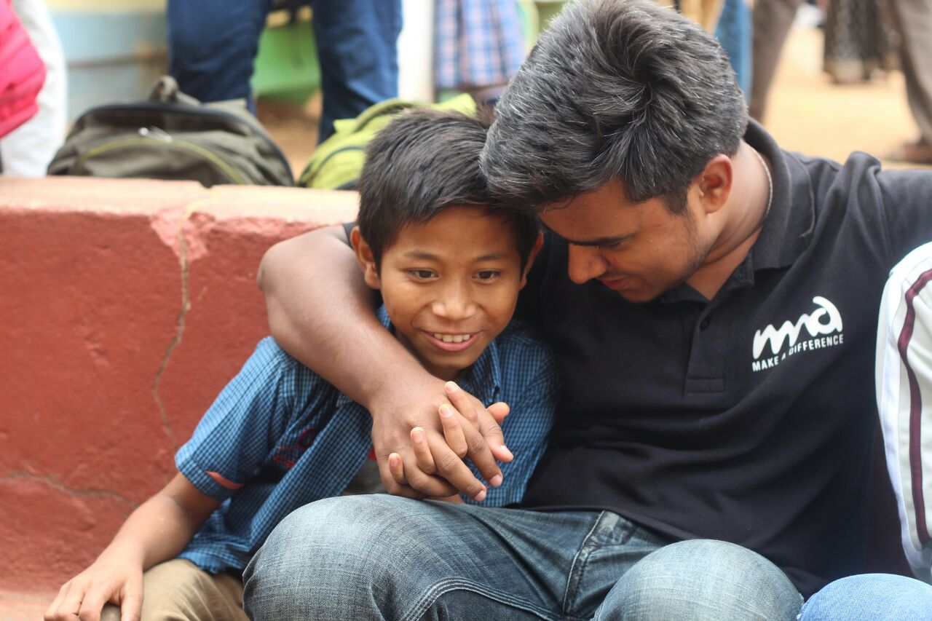

Slide 24
Notes:
This is an appropriate photo. This is included in the mix to show the difference

Slide 25
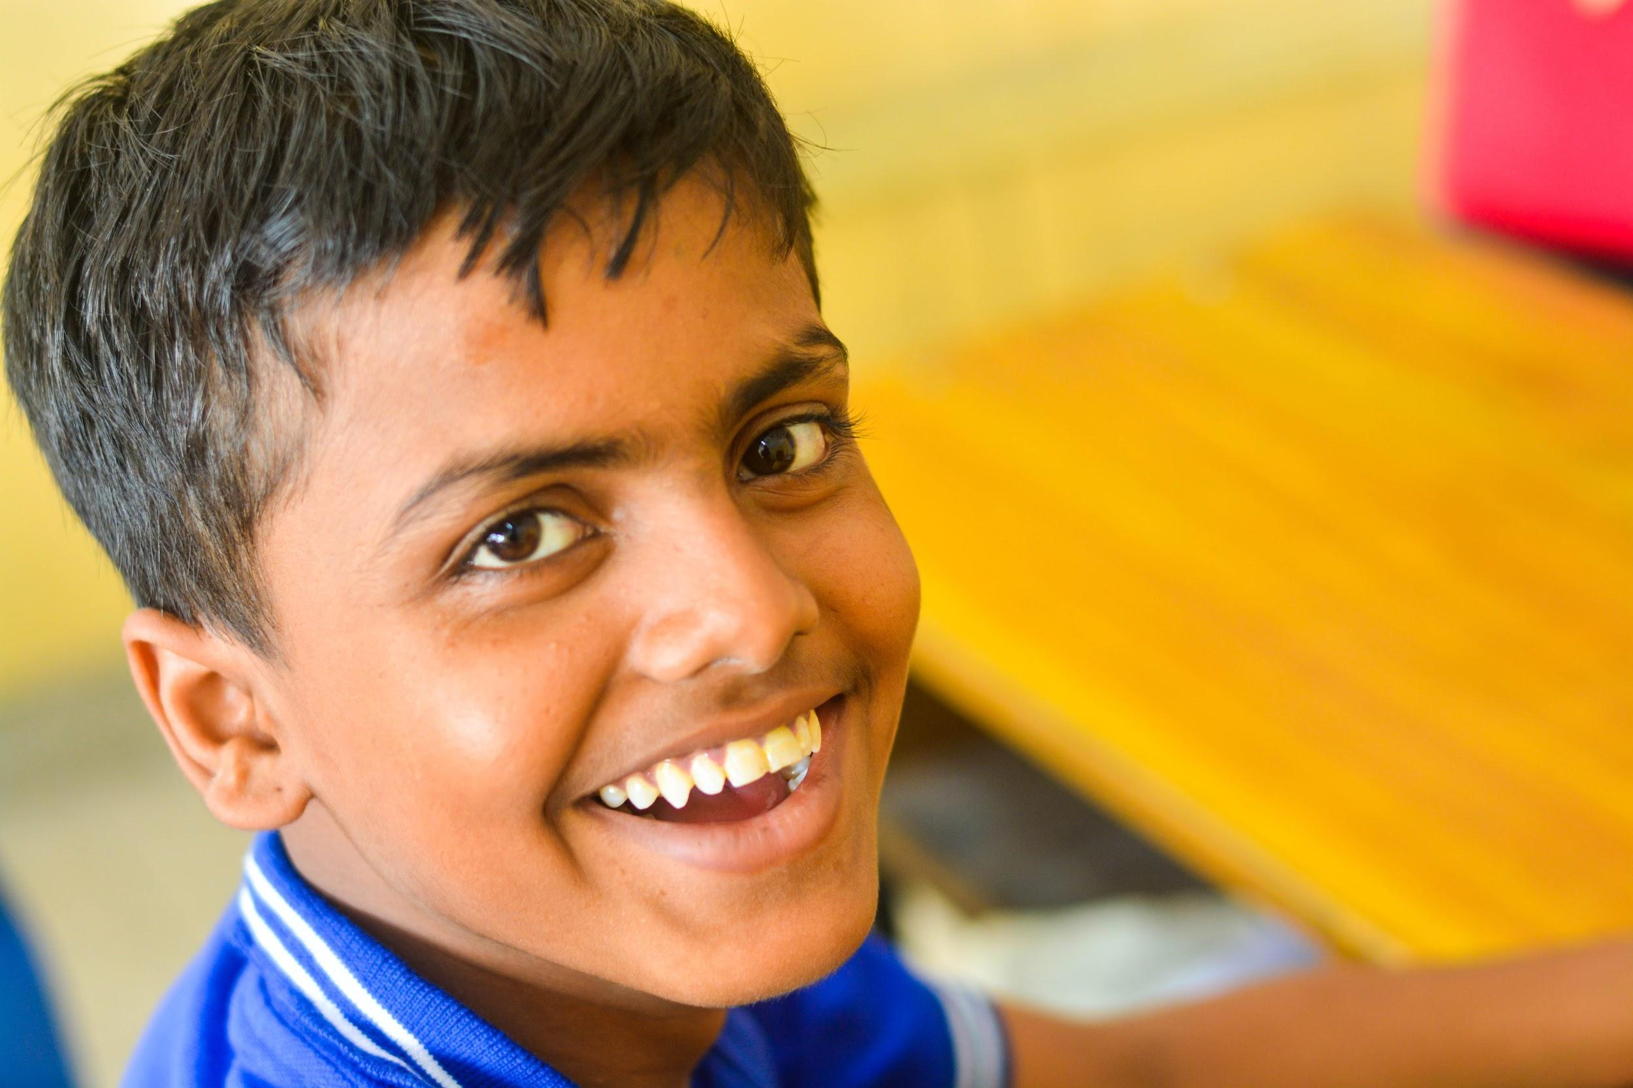

Slide 26
TECHNICAL DETAILS & GUIDELINES

Slide 27
GENERAL GUIDELINES
Resolution: Shoot and upload photos in the highest possible resolution. (For JPEGs to be considered "high resolution," they must meet or exceed a minimum of 7x5 @300 dpi.)
Photo editing: Do not modify photos unnaturally -- e.g., do not adjust contrast, color balance, apply filters or airbrush in a way that makes them look unrealistic.
Watermarks: Do not put watermarks, text or other labels onto the photos Do not superimpose your event logo or your photographer's information.
Ensure the Photographs are more candid in nature. Avoid taking shots of people posing for the picture. Try to capture the essence of the event. Avoid taking pictures of individual kids.

Slide 28
Techniques to keep in mind

Slide 29
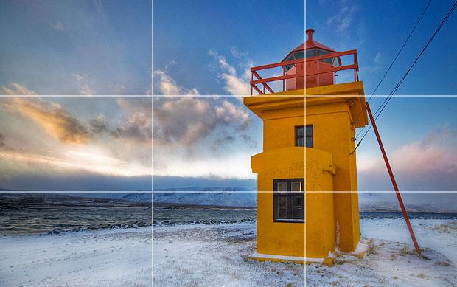
Rule of Thirds
Imagine that your image is divided into 9 equal segments by 2 vertical and 2 horizontal lines. The rule of thirds says that you should position the most important elements in your scene along these lines, or at the points where they intersect.
Doing so will add balance and interest to your photo. Some cameras even offer an option to superimpose a rule of thirds grid over the LCD screen, making it even easier to use.

Slide 30
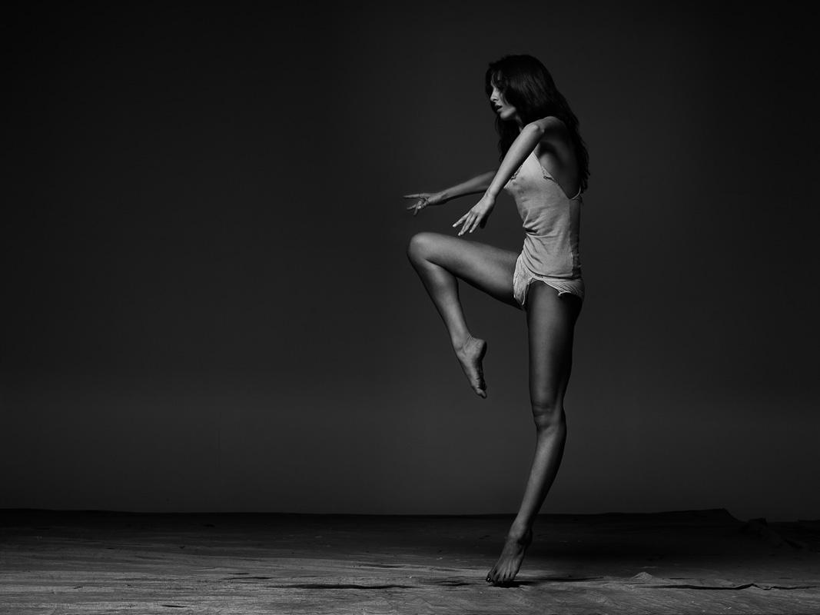
Leaving Space
This rule incorporates two very similar ideas: Breathing room and Implied movement
The leaving space rule probably comes naturally to you, but if you need a way to visualize it think of your frame as a box and your subject as something you’re going to be putting inside of a box.
To make your subject comfortable, you need to give him a bigger box that allows him some visual freedom and/or freedom of movement.
If your subject is looking at something (even something off-camera), make sure there is some “white space” for him to look into. (White space, of course, is not a literal term but a term used to describe the space that surrounds your subject, usually that part of the frame where there isn’t anything happening.)
Likewise, “implied motion” means that if your subject is in motion you need to give her some space that she can move into.

Slide 31
Simplification
As a general rule, simple images tend to be more appealing than complicated ones. This idea is similar to the previous “fill the frame rule,” in that it demands that you get rid of distracting elements in your photo (see how all these rules are related)? To use this compositional rule, simply ask yourself these questions:
Does that element add to my composition?
If it doesn’t, get rid of it. You can do this by recomposing so that the element is no longer in the frame, zooming in on your subject, using a wider aperture for a shallow depth of field, or simply cropping the image later in post processing.
Is this frame containing any other redundancies? Is my subject obstructed?
- To make sure this doesn’t happen prepare well for the shot and the subject is aware of the shoot.

Slide 32
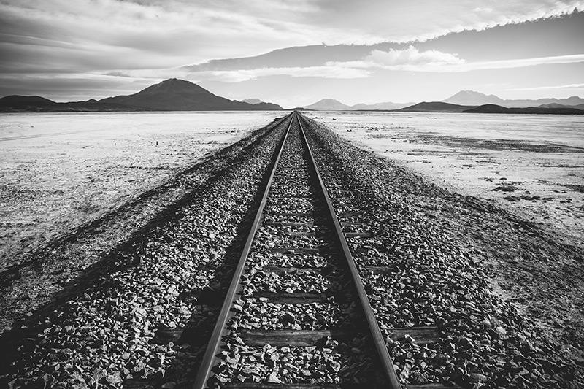
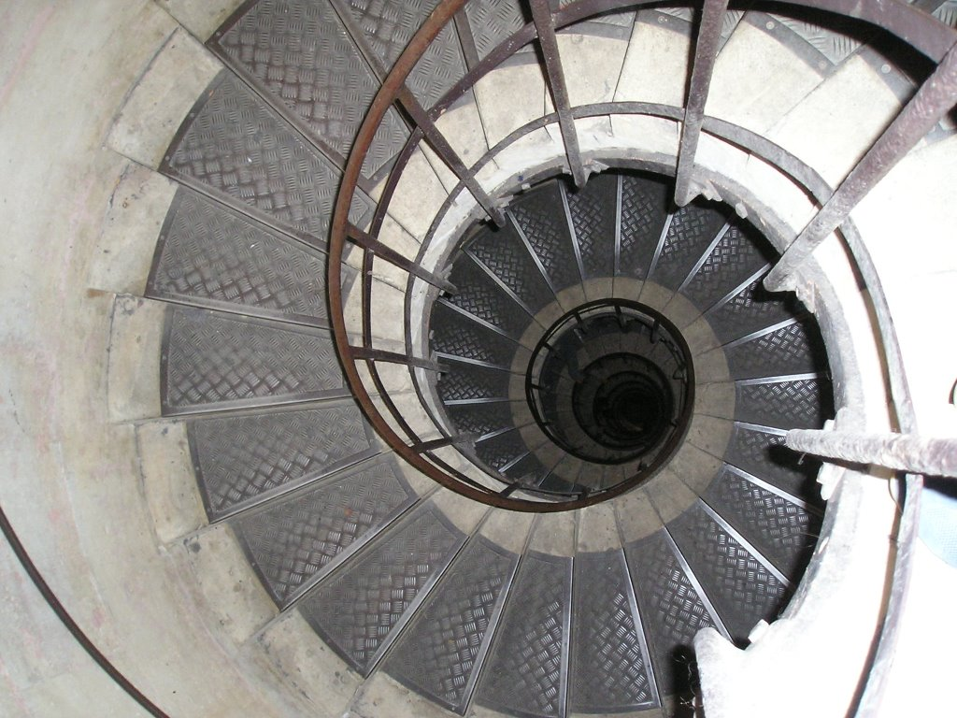
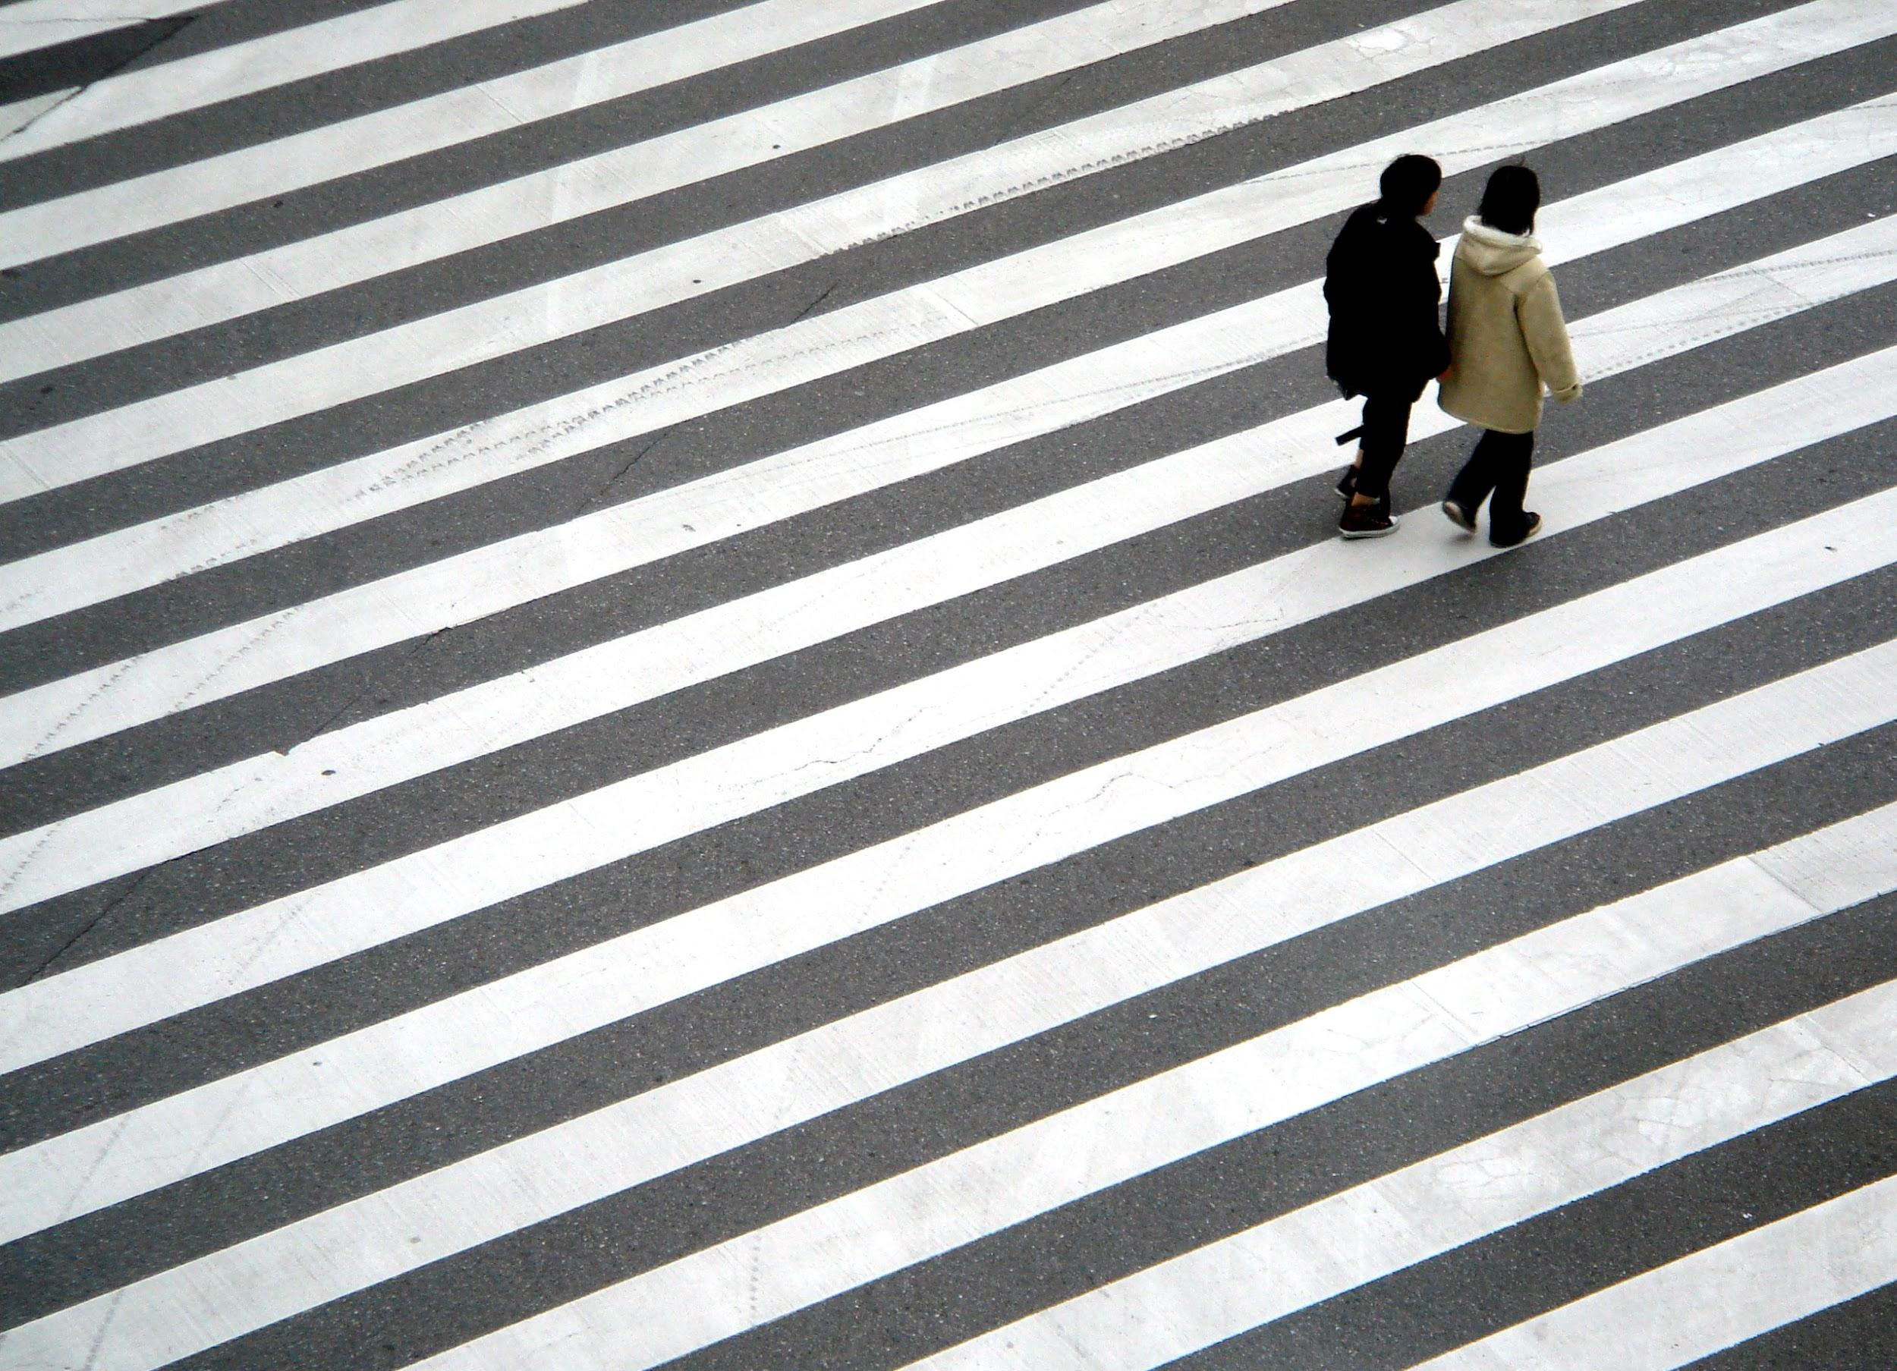
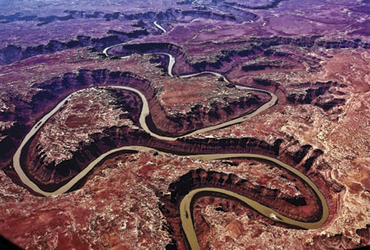
Leading Lines
When we look at a photo our eye is naturally drawn along lines. By thinking about how you place lines in your composition, you can affect the way we view the image, pulling us into the picture, towards the subject, or on a journey "through" the scene.
There are many different types of line - straight, diagonal, curvy, zigzag, radial etc - and each can be used to enhance our photo's composition.

Slide 33
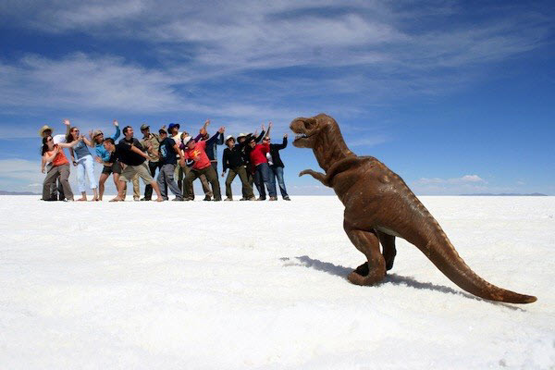
Viewpoint
Viewpoint can dramatically change the mood of a photograph. Let’s take an image of a child as an example. Shot from above, a photograph of a child makes her appear diminutive, or less than equal to the viewer. Shot from her level, the viewer is more easily able to see things from her point of view. In this case the viewer becomes her equal rather than her superior. But shoot that same child from below and suddenly there’s a sense of dominance about the child.
Perspective can also change the viewer’s perception of an object’s size. To emphasize the height of a tree, for example, shoot it from below, looking up. To make something seem smaller, shoot it from above, looking down.
Viewpoint isn’t just limited to high, low and eye-level of course – you can also radically change the perception of an object by shooting it from a distance or from close up.

Slide 34
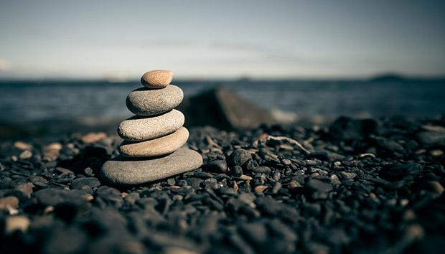
Depth
Depth is closely related to background, and is also dependent on the type of image you’re trying to capture. In a landscape, for example, you typically want everything to remain in focus. In a portrait, you may want that background to be out of focus. To isolate your subject from his or her background, use a wide aperture. To include the background, use a smaller one.
Depth can also be shown through other means. Including something in the foreground, for example, can add dimension to an otherwise two-dimensional appearing image. You can also overlap certain elements – since the human eye is used to seeing closer objects appear to overlap objects that are at a distance, your viewer will automatically interpret this information as depth.

Slide 35
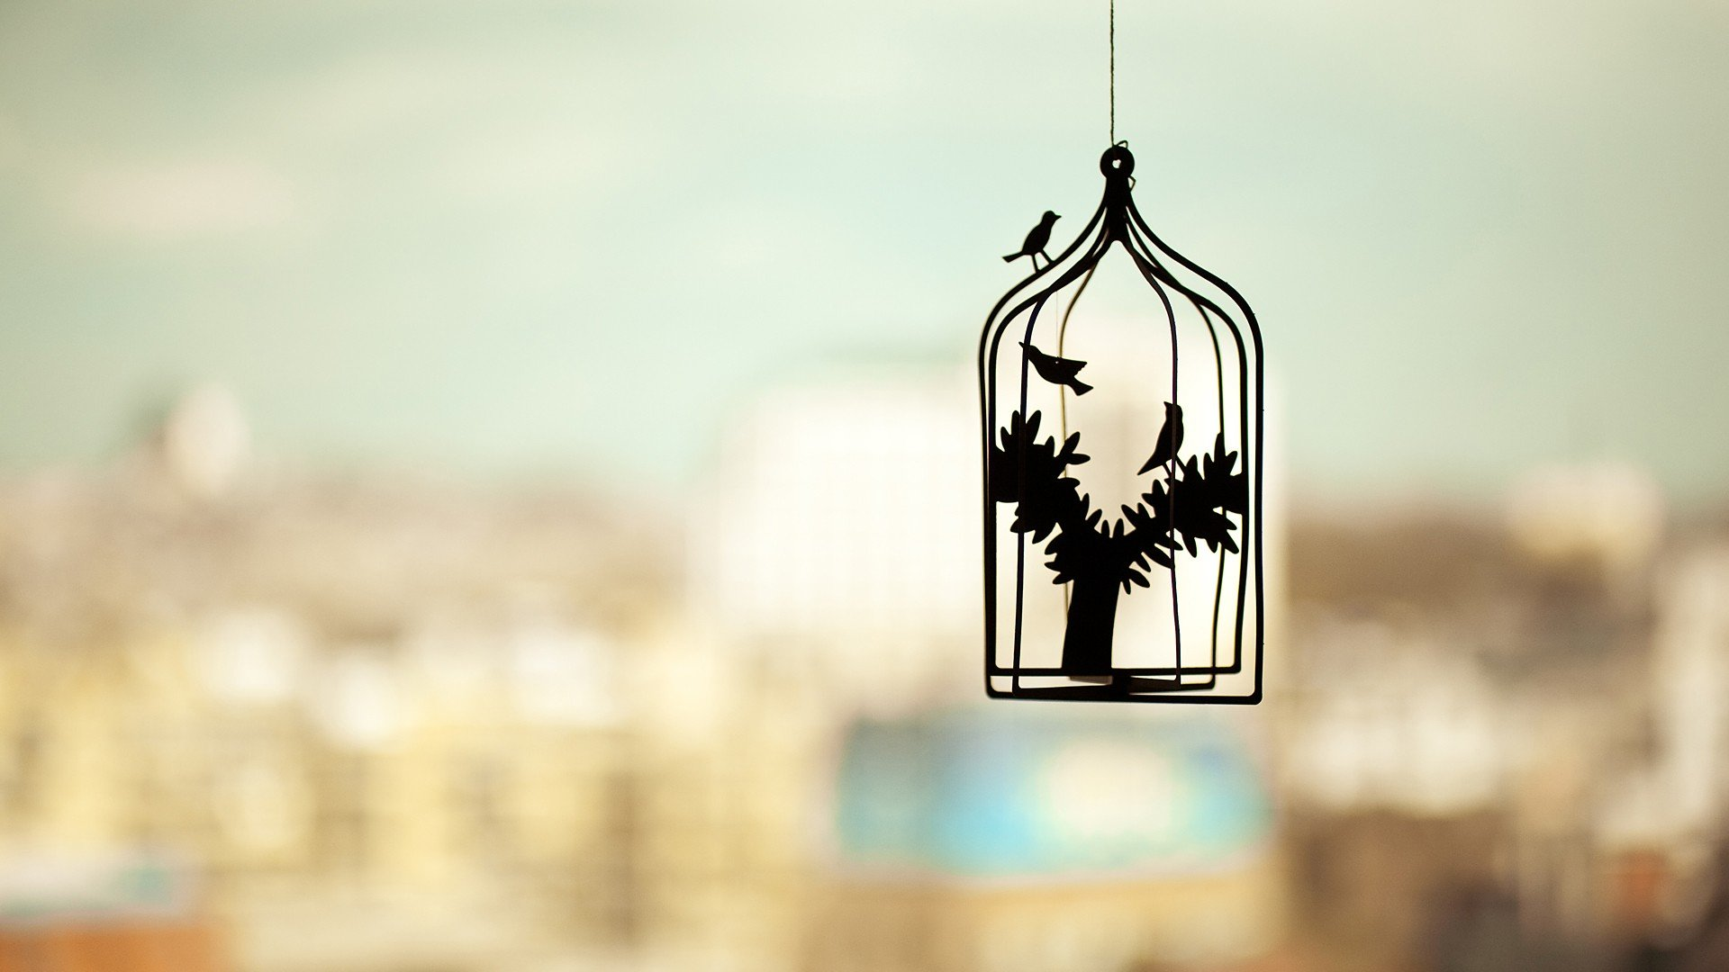
Background
This is one of those rules that almost all beginning photographers break. Sometimes we get so wrapped up in our subject that we don’t pay any attention to what’s going on behind them. If the background is busy and doesn’t add anything to your composition, try using a wider aperture so those distracting elements will become a non-descript blur. Or you can just try changing your angle. Instead of shooting the subject with all those beach-goers right behind her, angle her so that she’s in front of the water instead.
Not all backgrounds need to be excluded, of course. Just make sure you pay attention to them and ask yourself whether they will contribute to or detract from your final image. Your answer will let you know whether you should get rid of them or include them.

Slide 36
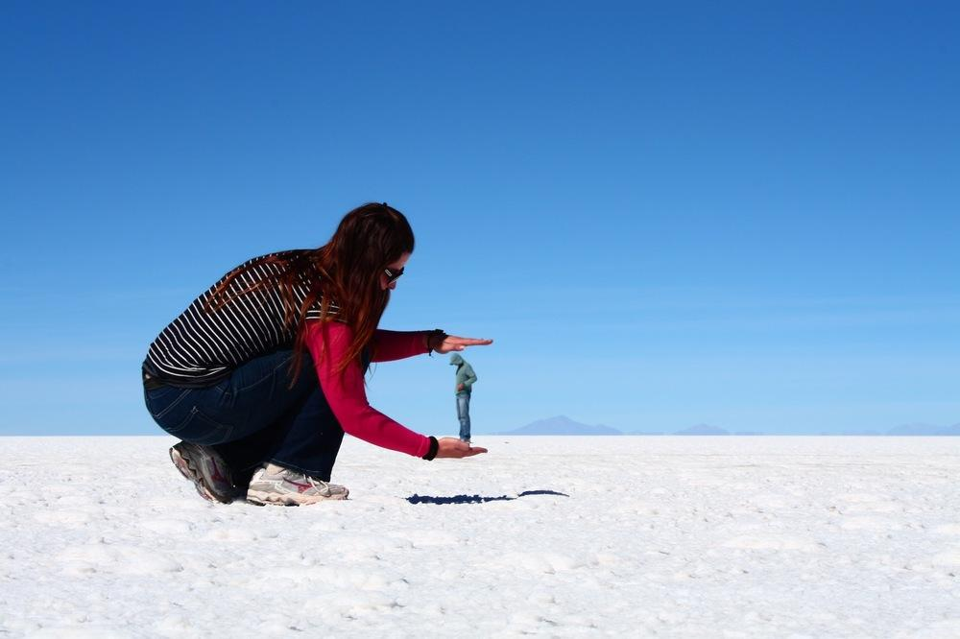
Experimentation
With the dawn of the digital age in photography we no longer have to worry about film processing costs or running out of shots. As a result, experimenting with our photos’ composition has become a real possibility; we can fire off tons of shots and delete the unwanted ones later at absolutely no extra cost. Take advantage of this fact and experiment with your composition - you never know whether an idea will work until you try it.

Slide 37
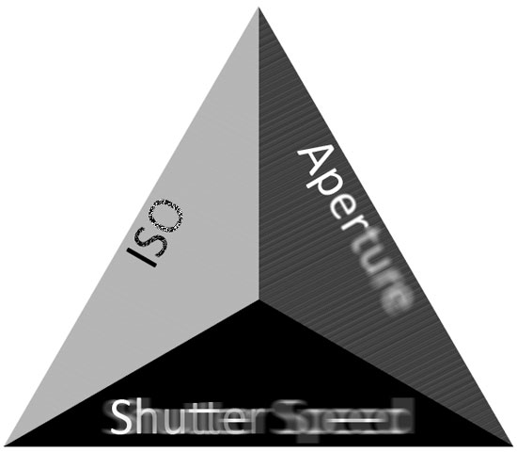
EXPOSURE: THE BASICS

Slide 38
EXPOSURE

Slide 39
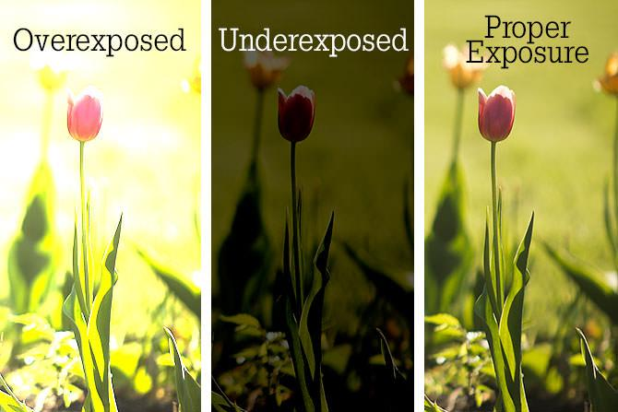
Given the amount of available light, there is a “right” exposure, where just enough light is allowed onto the camera’s sensor to make an accurate representation of the scene – i.e. preventing the picture from looking too bright or “blown out” because there was too much light, or at the other end, under-exposing the picture through allowing in insufficient light.

Slide 40
APERTURE

Slide 41
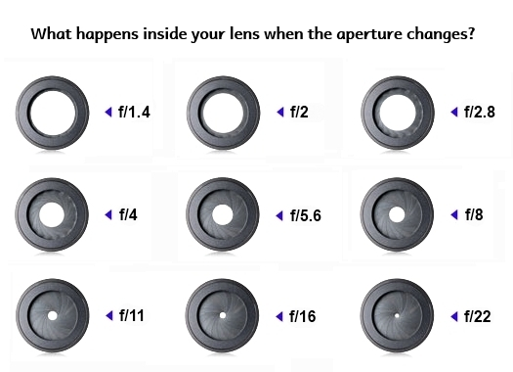
Put most simply – Aperture is ‘the opening in the lens.’
When you hit the shutter release button of your camera a hole opens up that allows your camera’s image sensor to catch a glimpse of the scene you’re wanting to capture. The aperture that you set impacts the size of that hole. The larger the hole the more light that gets in – the smaller the hole the less light.
Aperture is measured in ‘f-stops’.
Here is an inverse relationship – Low f-stop values mean more light is being let in. Aperture affects the depth of field (DoF).

Slide 42
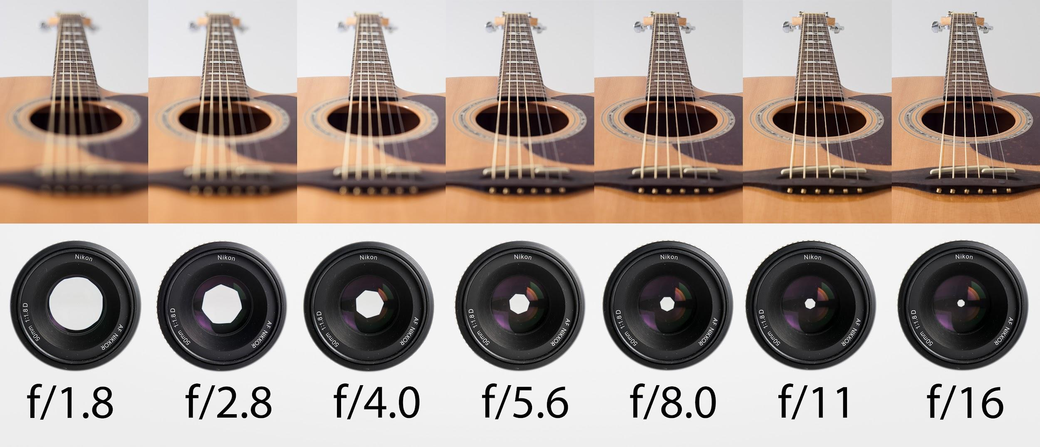
Depth of Field (DOF) is that amount of your shot that will be in focus.
Large depth of field means that most of your image will be in focus whether it’s close to your camera or far away.
Small (or shallow) depth of field means that only part of the image will be in focus and the rest will be fuzzy.

Slide 43
SHUTTER SPEED

Slide 44
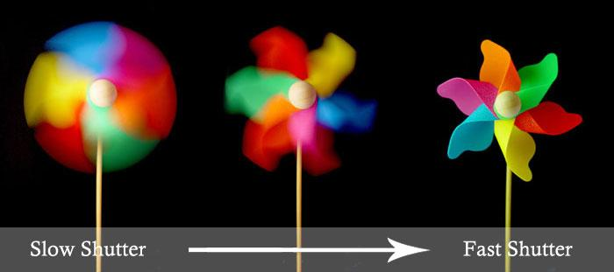
Defined most basically – shutter speed is ‘the amount of time that the shutter is open’.
Shutter speed is measured in seconds – or in most cases fractions of seconds. The bigger the denominator the faster the speed (ie 1/1000 is much faster than 1/30).
In most cases you’ll probably be using shutter speeds of 1/60th of a second or faster. This is because anything slower than this is very difficult to use without getting camera shake. Camera shake is when your camera is moving while the shutter is open and results in blur in your photos.

Slide 45
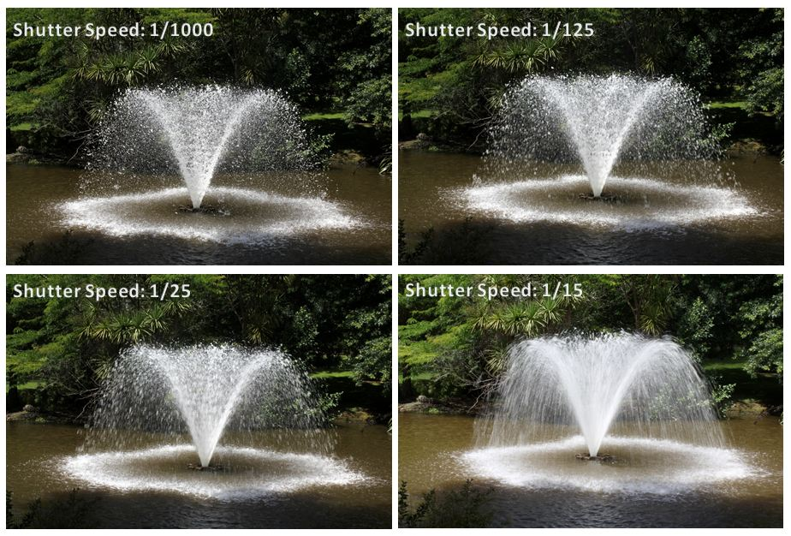
If you’re using a slow shutter speed (anything slower than 1/60, incase of bad lighting at the shelter home) you will need to either use a tripod or some type of image stabilization (more and more cameras are coming with this built in).
To freeze movement in an image you’ll want to choose a faster shutter speed and to let the movement blur you’ll want to choose a slower shutter speed. The actual speeds you should choose will vary depending upon the speed of the subject in your shot and how much you want it to be blurred.

Slide 46
ISO

Slide 47
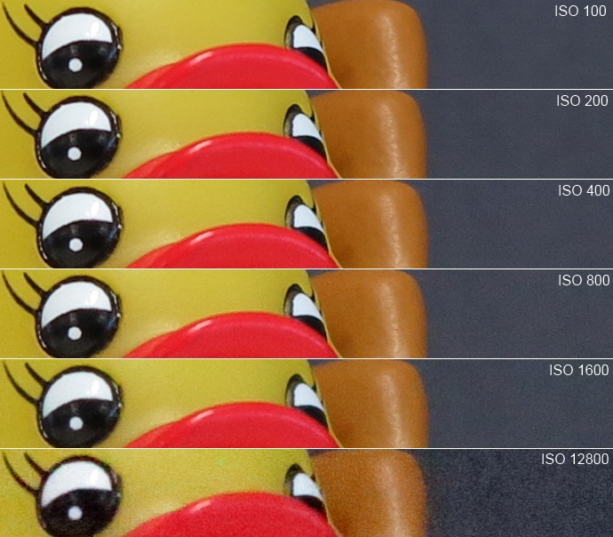
At higher ISO settings the sensor is more sensitive to light. ISO produces digital noise/grain, in turn affecting the quality of the image. An ISO of 100 is perfect for very sunny environments. ISO 200-400 works for overcast outdoor daylight, outdoor shade, or indoors where the scene is well-lit. ISO 800 can sometimes be used in low light outdoors or indoors without a flash. Mind the shutter speed — if it gets too slow you can either increase ISO to make it faster, use a tripod to accommodate the slower shutter speed, or use flash. Indoor and outdoor low-light situations without a flash often call for an ISO speed of 1600 or more. Beware though, as your photos can become grainy with a high ISO (I try not to go higher than ISO 400 for that reason). To avoid graininess in these low-light situations, set the ISO low and mount your DSLR on a tripod to get a clear shot.

Slide 48
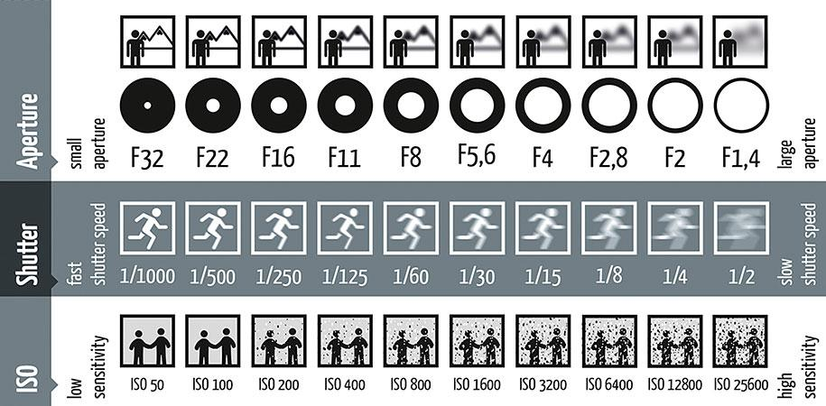

Slide 49
Different Exposure Conditions

Slide 50
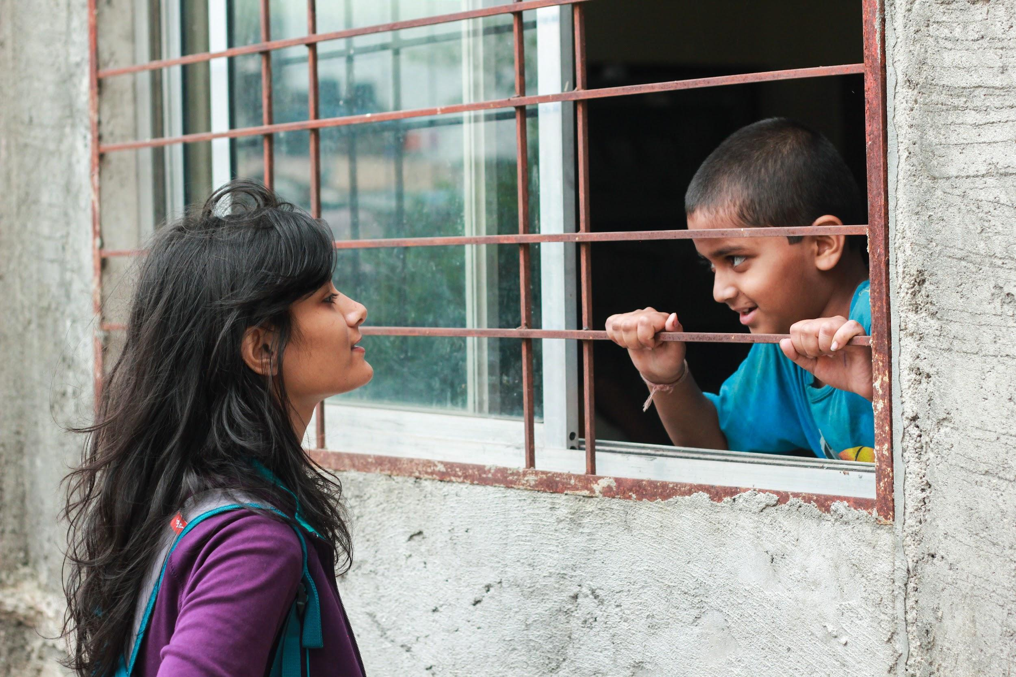
Daylight
This photograph has excellent lighting conditions allowing you to use fast settings on your camera.

Slide 51
Sunny
Be careful of overexposure
Try to avoid noon
Use a diffuser (if possible). The 5 in 1 reflectors are really cheap. They work as a diffuser and as reflectors. (Find them here. And these for your pop-up flash.)
Notes:
You put sunscreen on because you know exposed skin burns under the midday sun. It's a similar situation for your camera. During the summer months, the sun can be extremely bright, especially at noon. This means you will have to protect your shots from being overexposed by increasing the shutter speed or decreasing the aperture. Both changes reduce the amount of light coming throughout the lens. Don't be surprised if you have to increase your shutter speed up to 1/1000s or even 1/1500s to get the shot you want. This can be perfectly normal in the middle of a very bright day.
Many subjects look their best when light is shining on them from the sides. That's why sunrise and sunset are the best times to take any photo. In the middle of the day, the sun shines directly overhead and can sometimes cast strong shadows on your subject (usually the face). That's why it's sometimes best to wait an hour or two for the sun to move just slightly across the horizon so you can get a more sideways kind of lighting. This isn’t always necessary. If you’re already out and about, don’t let the sun stop you from rattling off a few shots.

Slide 52
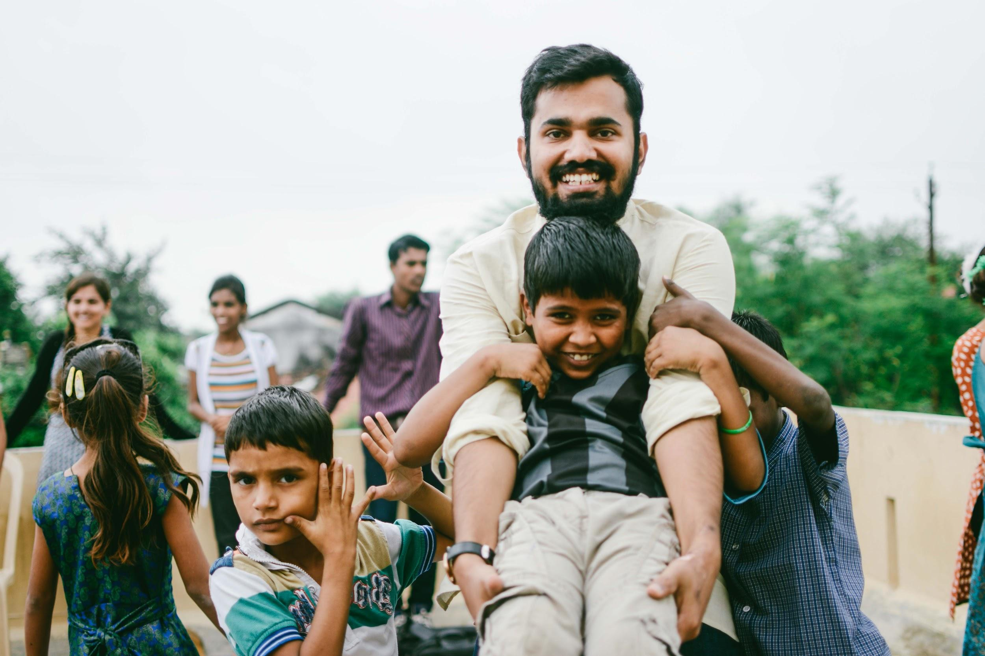
Cloudy + Evening
Try shooting from slightly above your subject to get better light in the eyes.
Use your surroundings to create directional light.
Be thoughtful when including the sky in your image.
Watch your settings.
Notes:
When your subject looks slightly down or even straight ahead on an overcast day it can be hard to get enough light in their eyes to make the beautiful catchlights we strive for as photographers. However, if you can get higher than your subject by having them squat down, bringing a step-stool, or finding a hill or structure to raise you above eye level, they will be looking up at the sky. Suddenly you will find their whole eyes filled with light. If it’s too bright this may make them squint, but on the dark, overcast days this can make for a beautiful portrait. It’s a really easy thing to do with babies, and the flat lighting works so well with their sweet little faces, but it’s a tip that works for any age.
Light on an overcast day tends to be pretty flat. This can cause people to look somewhat flat and dimensionless. To create dimension, you can use anything in your surroundings — buildings, trees, a fence, etc. — to block some of the light in one or more directions to create directional light. You can also use a reflector, or even a flash to craft directional light on an overcast day, to help mold the lighting.
A dark, stormy sky can be as interesting in a portrait as a beautiful blue sky. That being said, a flat overcast sky often wants to blow out to white or turn a light gray, and can really take away from a beautiful portrait. Consider not including the sky at all in your image or conversely embracing the flat backdrop as an integral part of your image
Since there is generally less light on an overcast day, you’ll want to watch your settings to make sure you are getting a proper exposure. Often you’ll want to bump your ISO to 400, 800, or even 1600 to let in enough light. Even then you may need to open up your aperture or slow your shutter. Just be careful not to let your shutter speed drop lower than you can easily freeze the scene in front of you when trying to get a nice sharp portrait.

Slide 53
General Tips

Slide 54
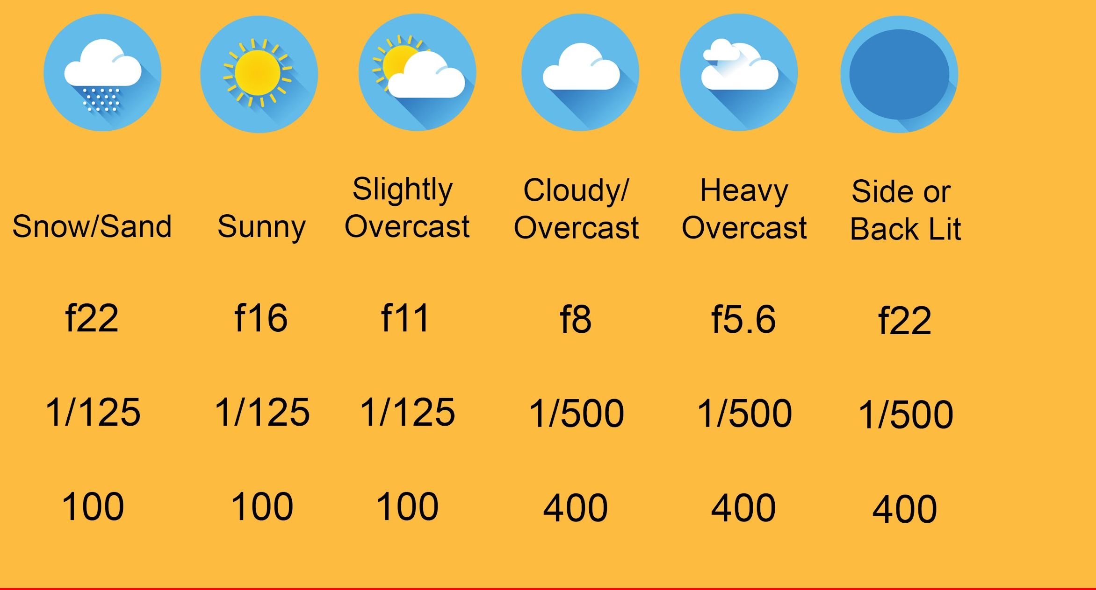
A lot of times, there are some settings we can stick to during particular weather conditions. Try these out with different ISO and Shutter speed settings according to your need!

Slide 55
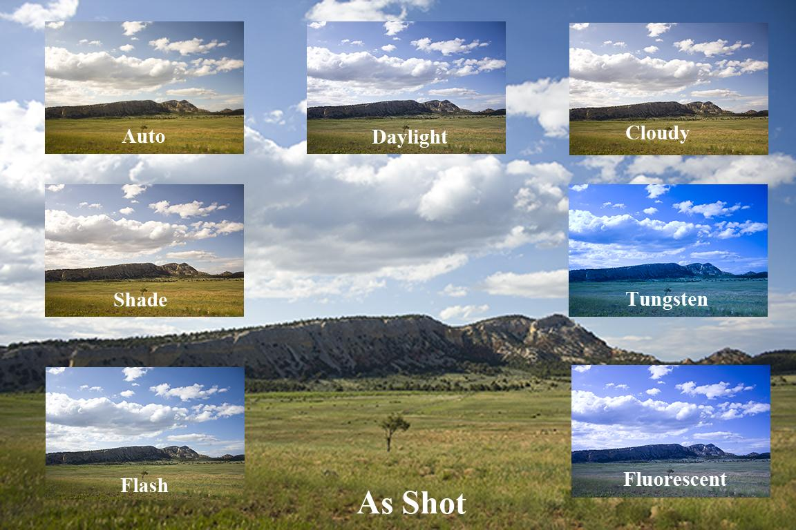
Use White Balance settings to achieve more natural-looking photos. Different light sources create a variety of color casts in our photos, not all of which look very natural. DSLR cameras have white balance settings to choose from to help counteract these problems. Some of the most common white balance settings are Auto, Daylight, Shade, Cloudy, Tungsten, Fluorescent and Flash. Try experimenting with these settings, at all different times of day, in different situations. You might even discover some interesting effects.

Slide 56
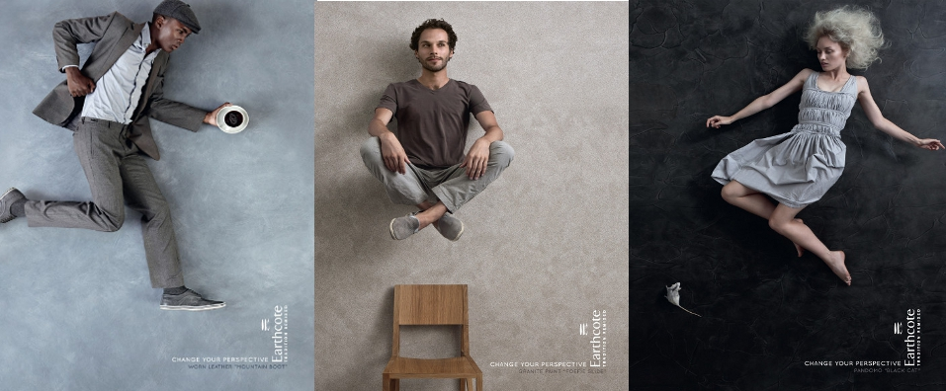
Change up the perspective of your shots. Think about depth and spatial relationships between objects in your photos. Get down on the ground, at eye level, shoot from above, look up, see what’s behind you, move in close. Some of the most interesting shots can come from veering away from your normal photography habits.

Slide 57
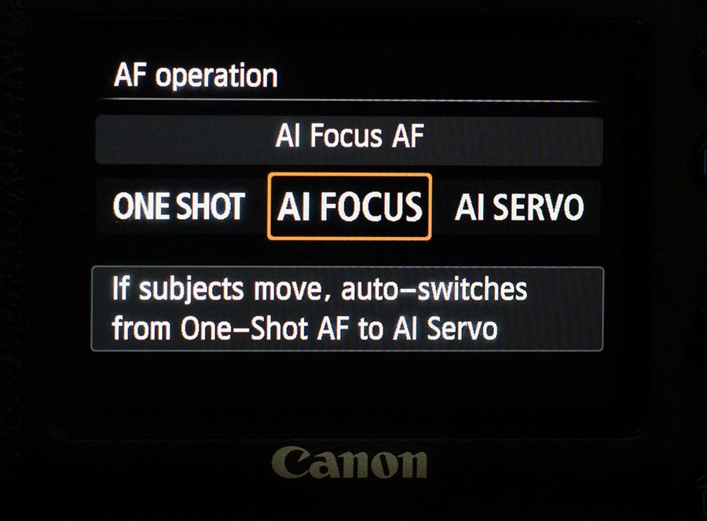
Get to know your camera’s autofocus capabilities (AF mode). When you look through your camera’s lens you will see an array of focus points. The center focus point (which is the most sensitive point) should be pointed straight at your subject. Push the shutter button halfway down to lock the focus, then recompose your shot if you want (because the subject does not have to be in the dead center of your composition), then shoot. If your subject is way off center, you’ll get a clearer shot if you select an off-center focus point that lines up with your subject. If using a wide aperture setting like f/2.8, do not use the lock focus/recompose method, as your subject may become blurred. Instead, choose a focus point closest to your subject to ensure clarity. There are basically two AF modes — ‘One Shot’ and ‘Continuous.’ Canon has One Shot mode and Al Servo mode (continuous), as well as Al Focus mode which is really like One Shot mode with an automatic sensor that allows it to go into Al Servo mode when it detects motion. Greek? Let me make it easy for you. When you are shooting a still subject use One Shot mode. If you have a moving subject that you wish to capture in focus, set your camera to its Continuous focus mode (which is Al Servo on Canon), so that it continually focuses on your moving subject.

Slide 58
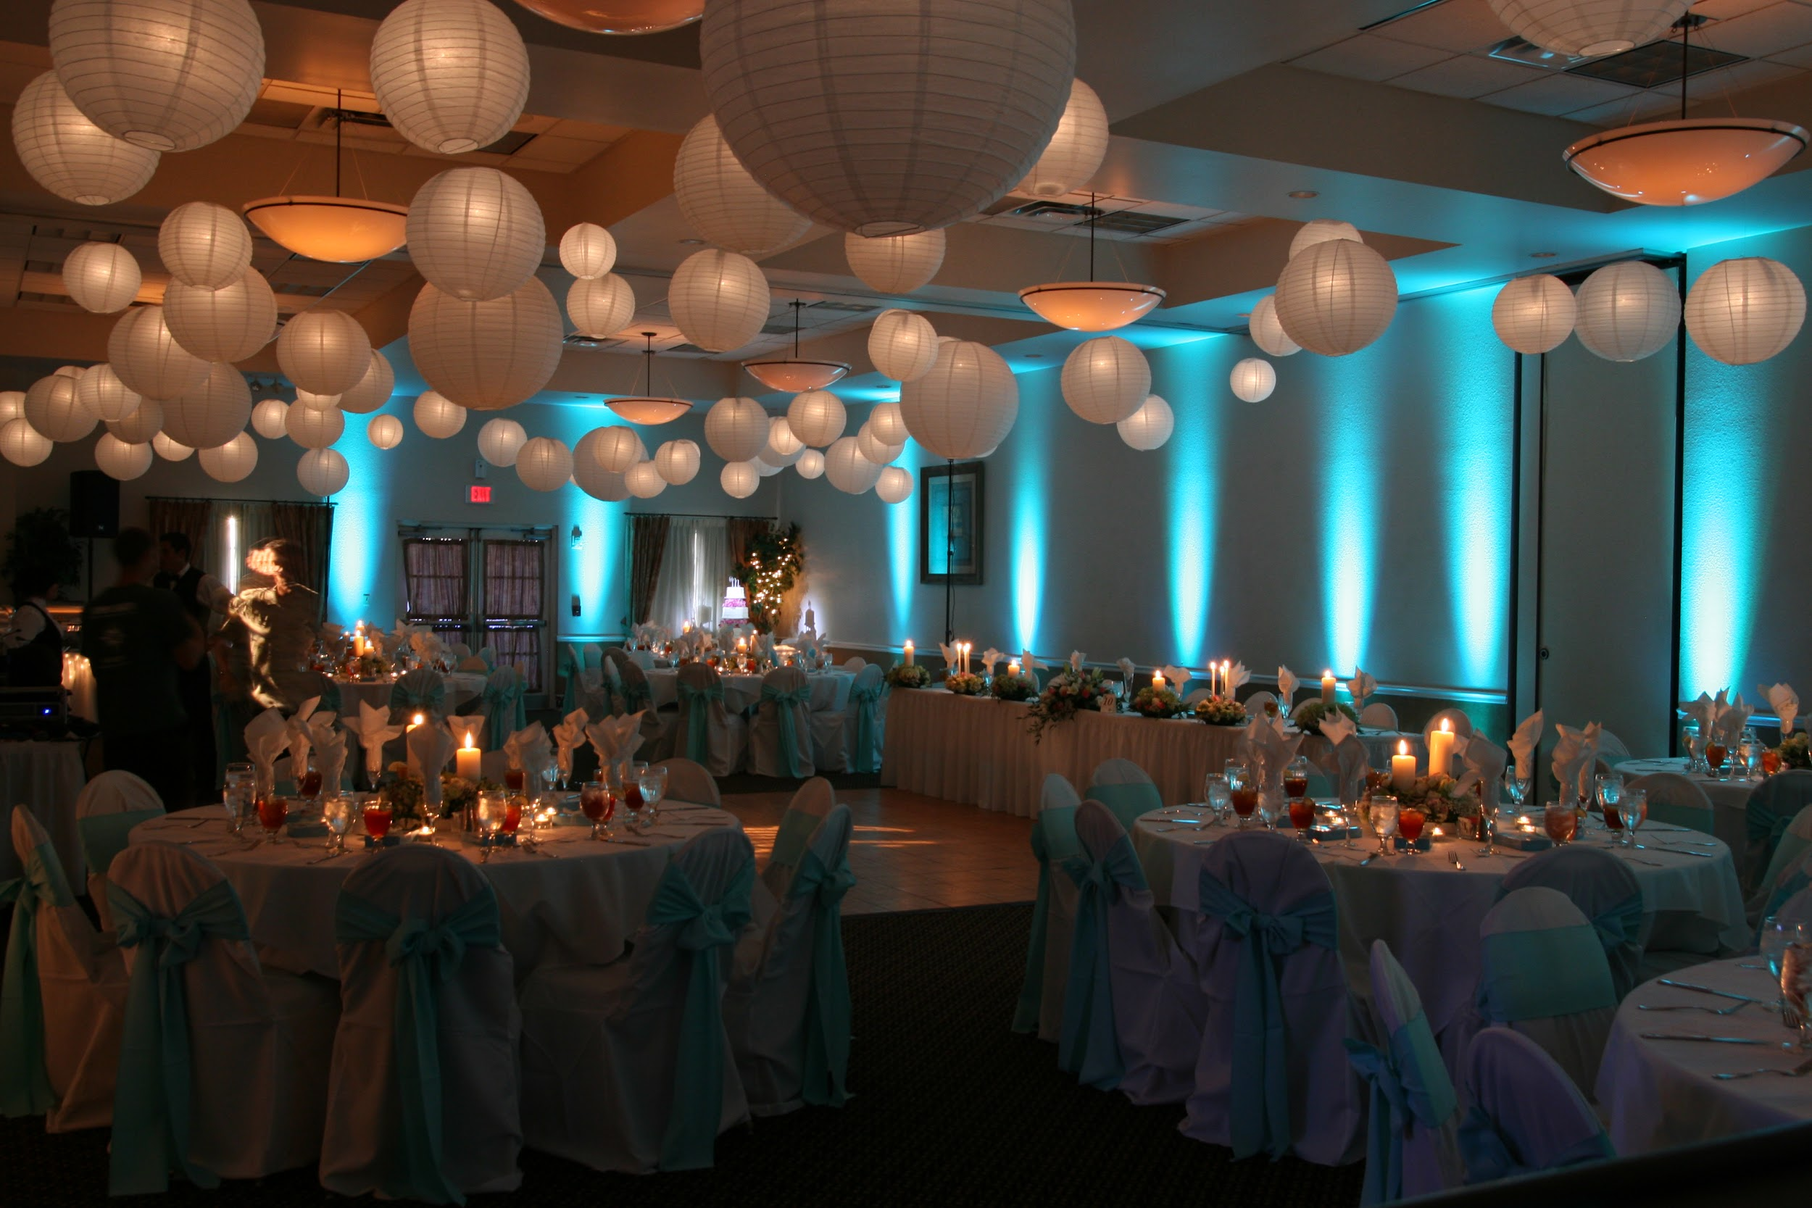
Low light problems in the shelters can be solved by simply putting up paper chinese lanterns within the centre. (They are really cheap! They can also be made easily.)

Slide 59
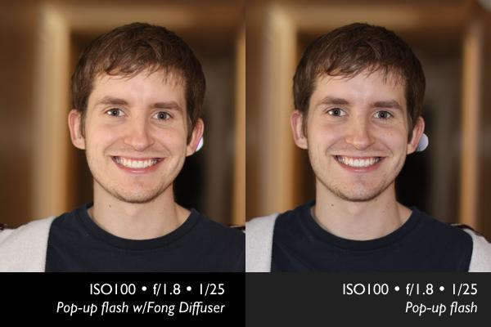
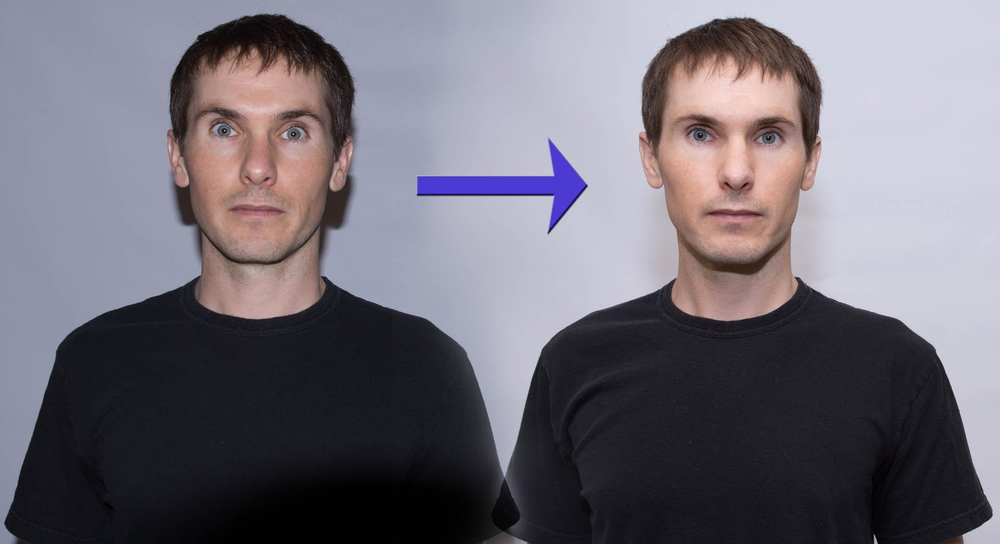
DO NOT USE YOUR POP UP FLASH! Here’s why.
If you have no other choice/want to use the pop up flash, use it with a diffuser, or use an external flash.

Slide 60
Don’t forget to go through these links :)
12 Most Common Exposure Problems Faced by Photographers and How to Fix Them
If you are still unsure of which software to use for post processing, I’d suggest you to give Lightroom CC a spin. You can follow this link to see Lightroom tutorials by Julieanne Kost, Principal Digital Imaging Evangelist, Adobe Systems, Inc. It is one of the easiest high end softwares to use.
Lightroom 6 / CC Tutorial - Quick Start Guide
The Ultimate Beginner's Introduction to Exposure
Introduction to White Balance
In case of any doubts, please do not hesitate to reach out to Kruthika.

Slide 61
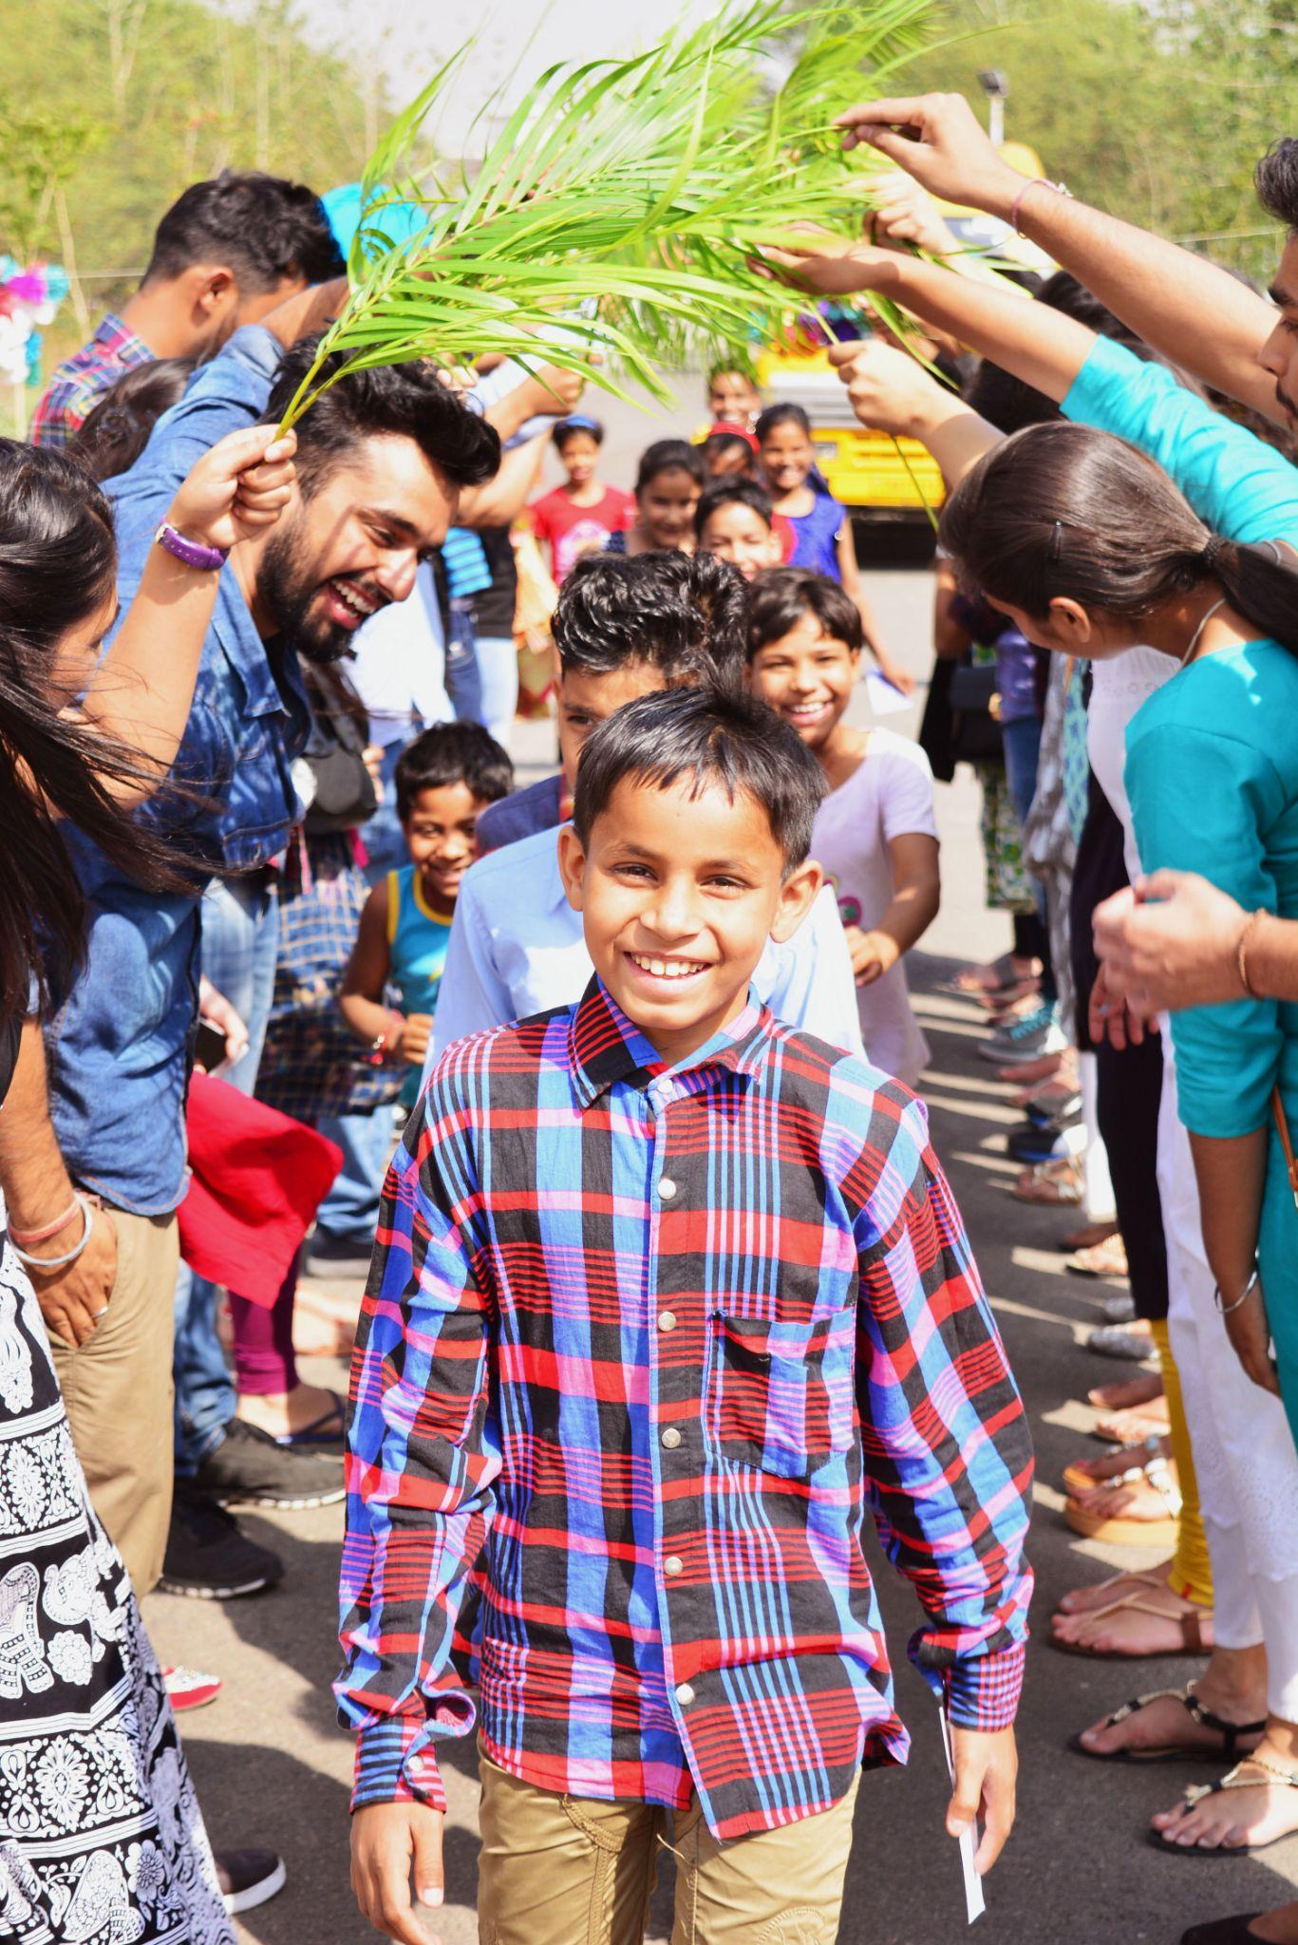
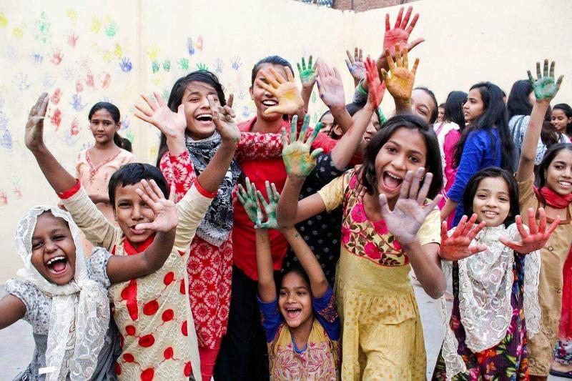
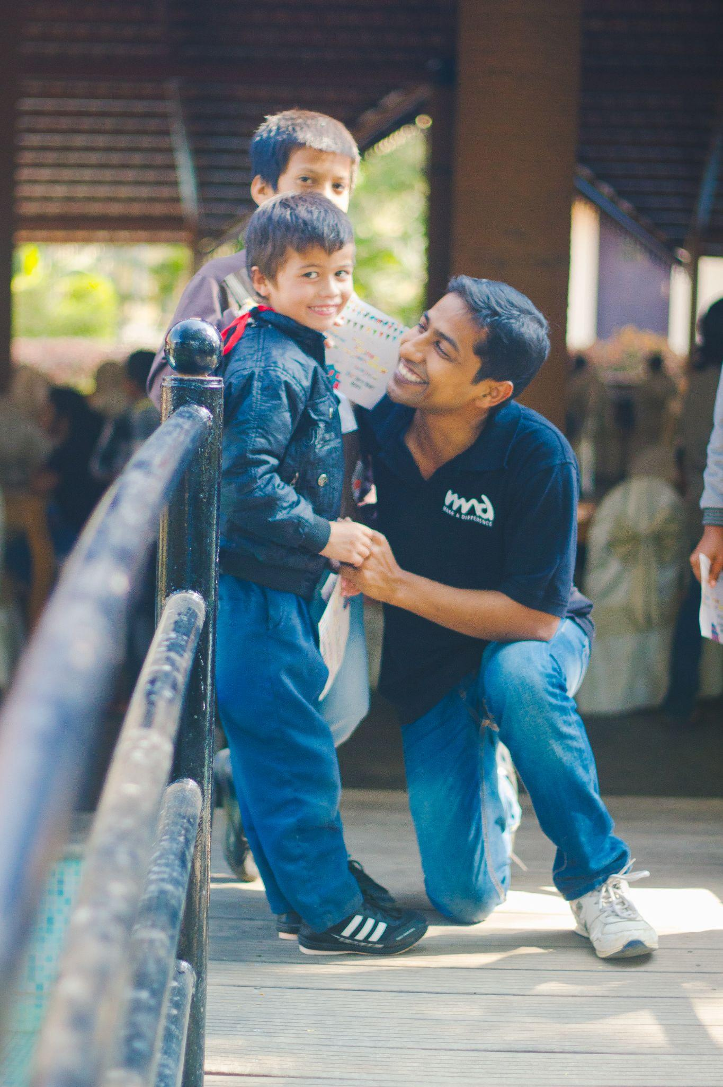
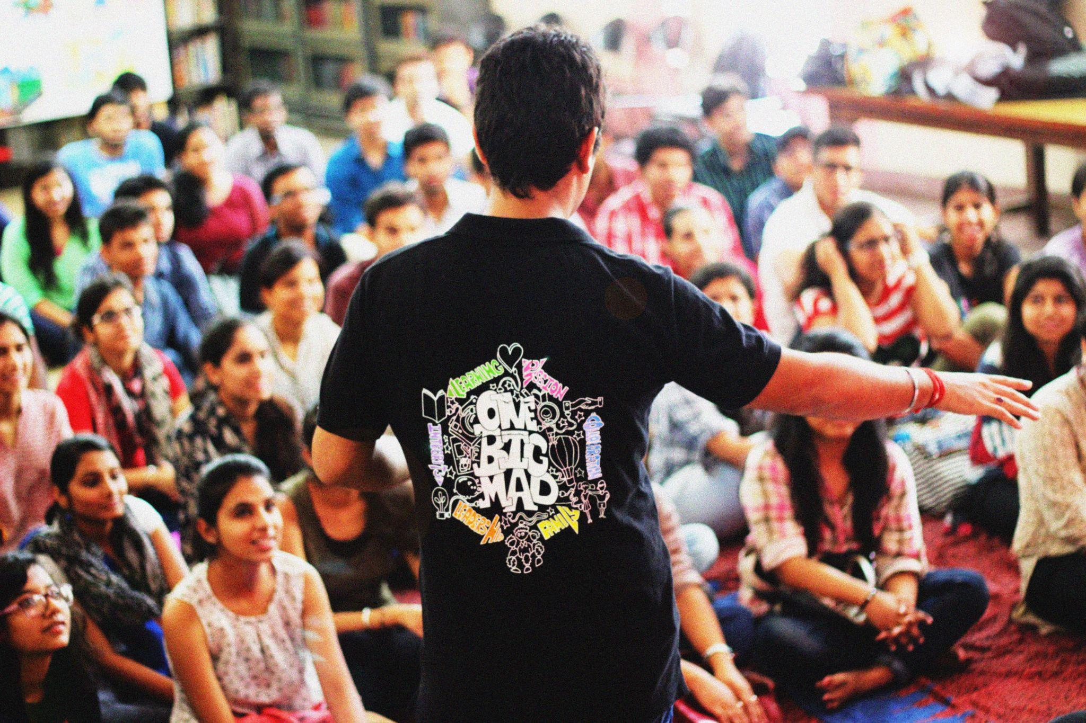
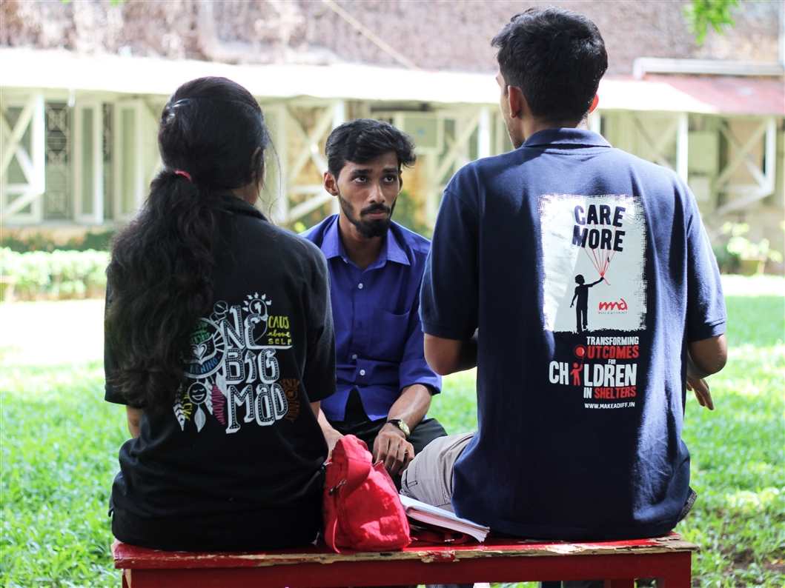

Slide 62
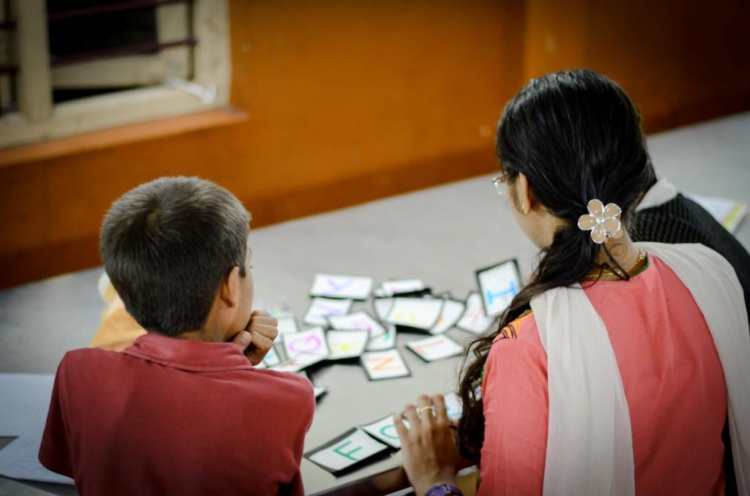
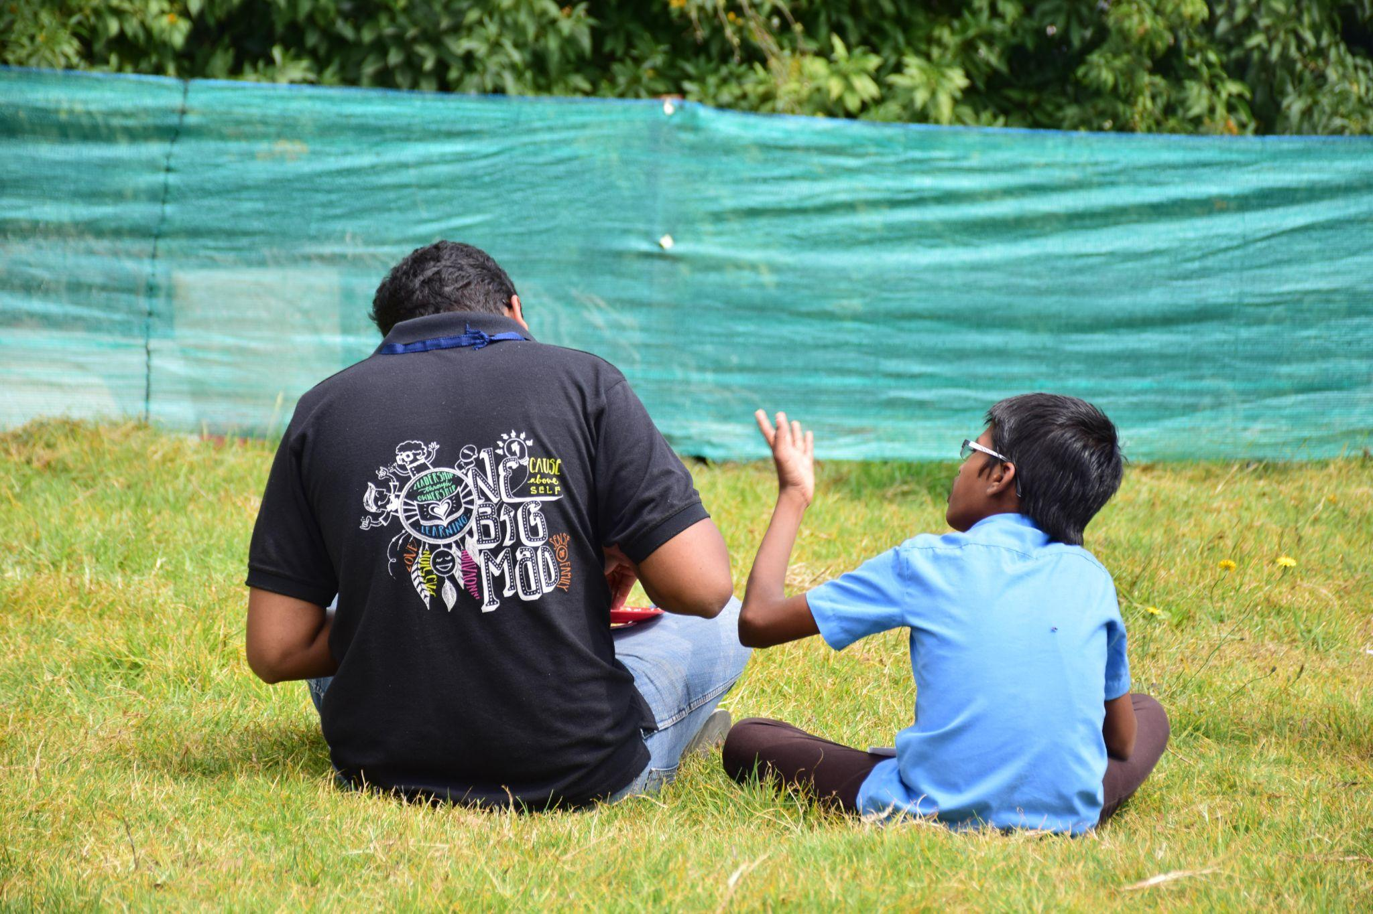
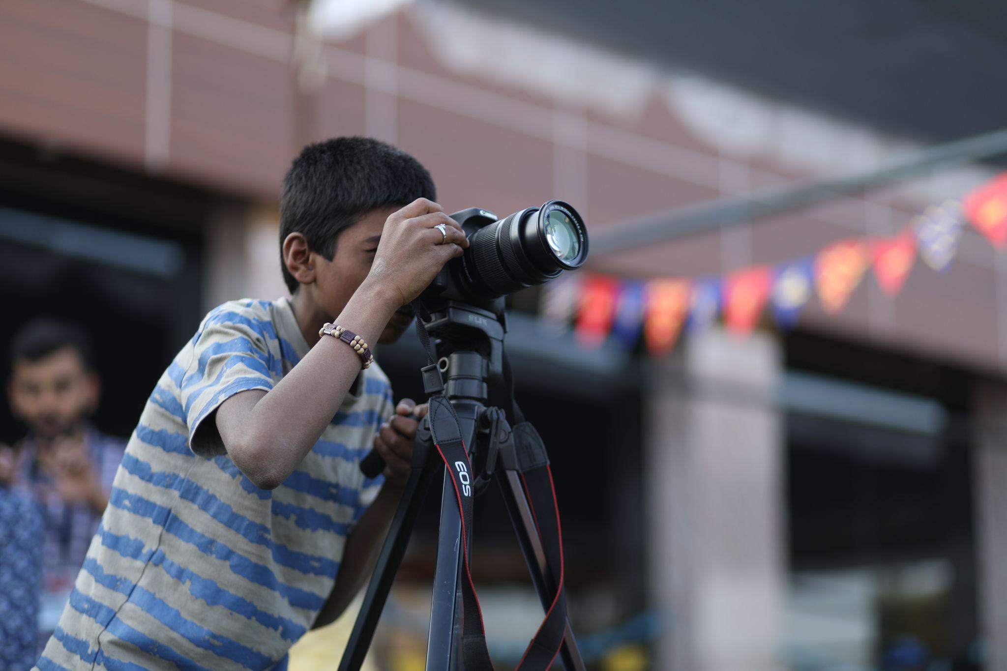
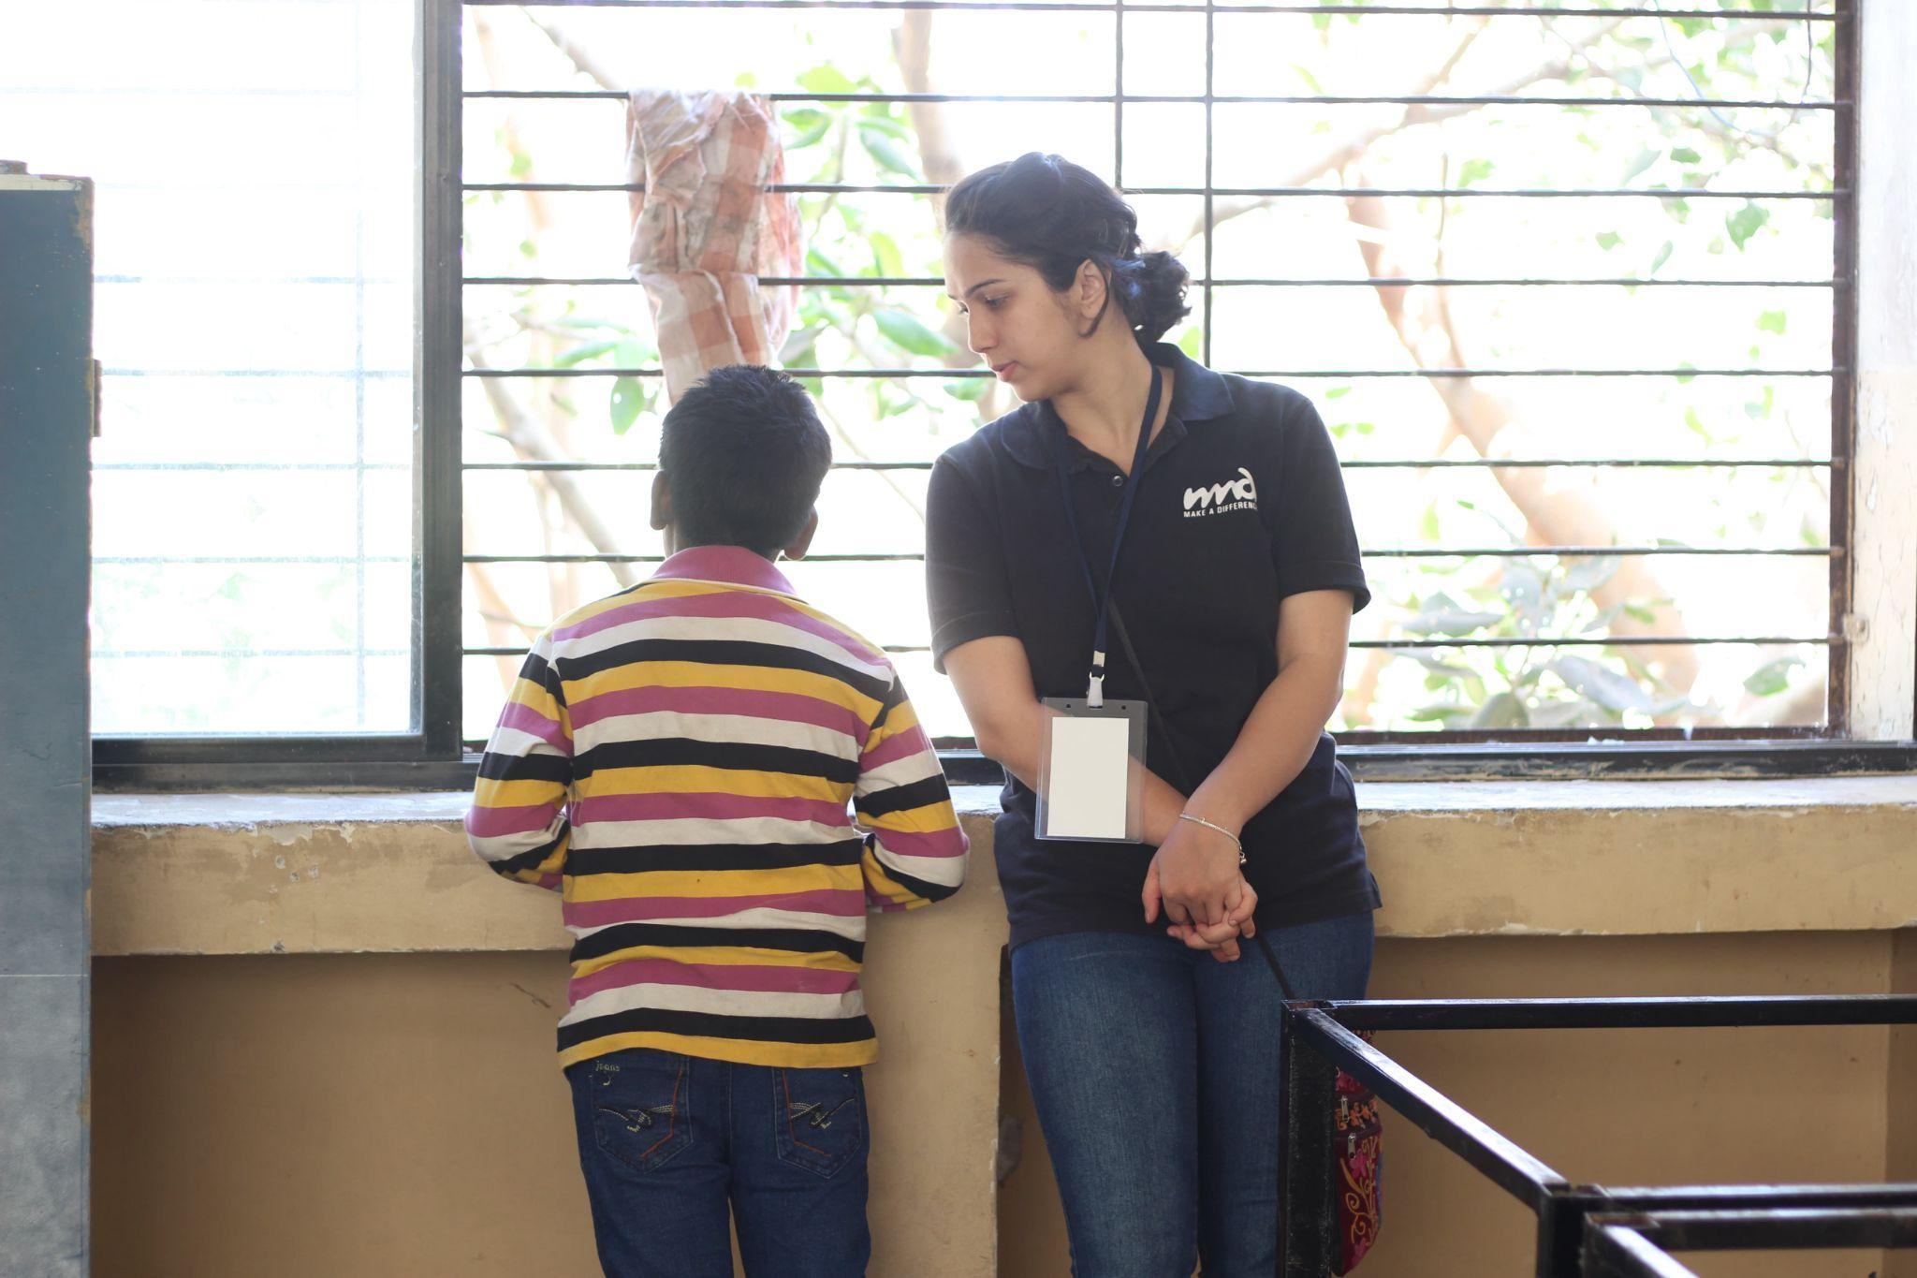
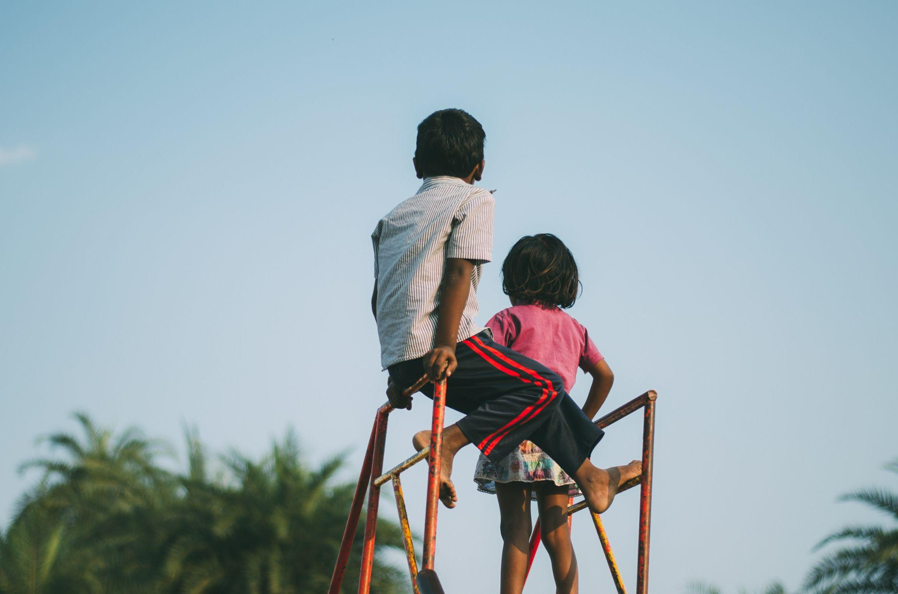
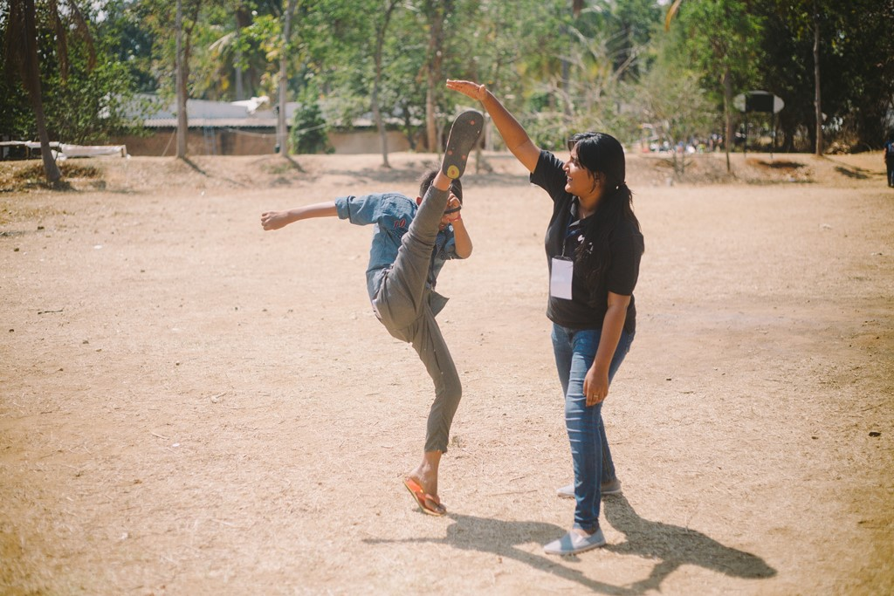

Slide 63
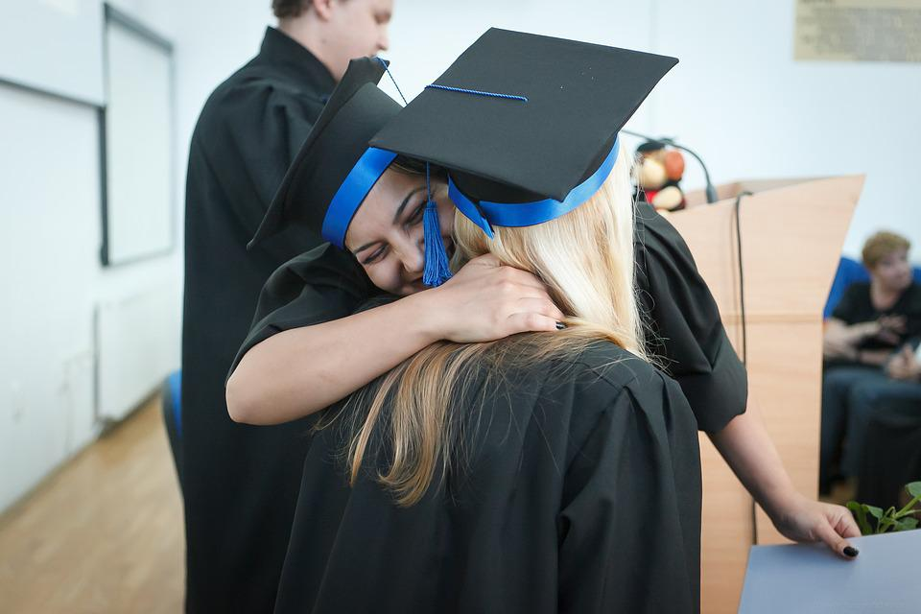
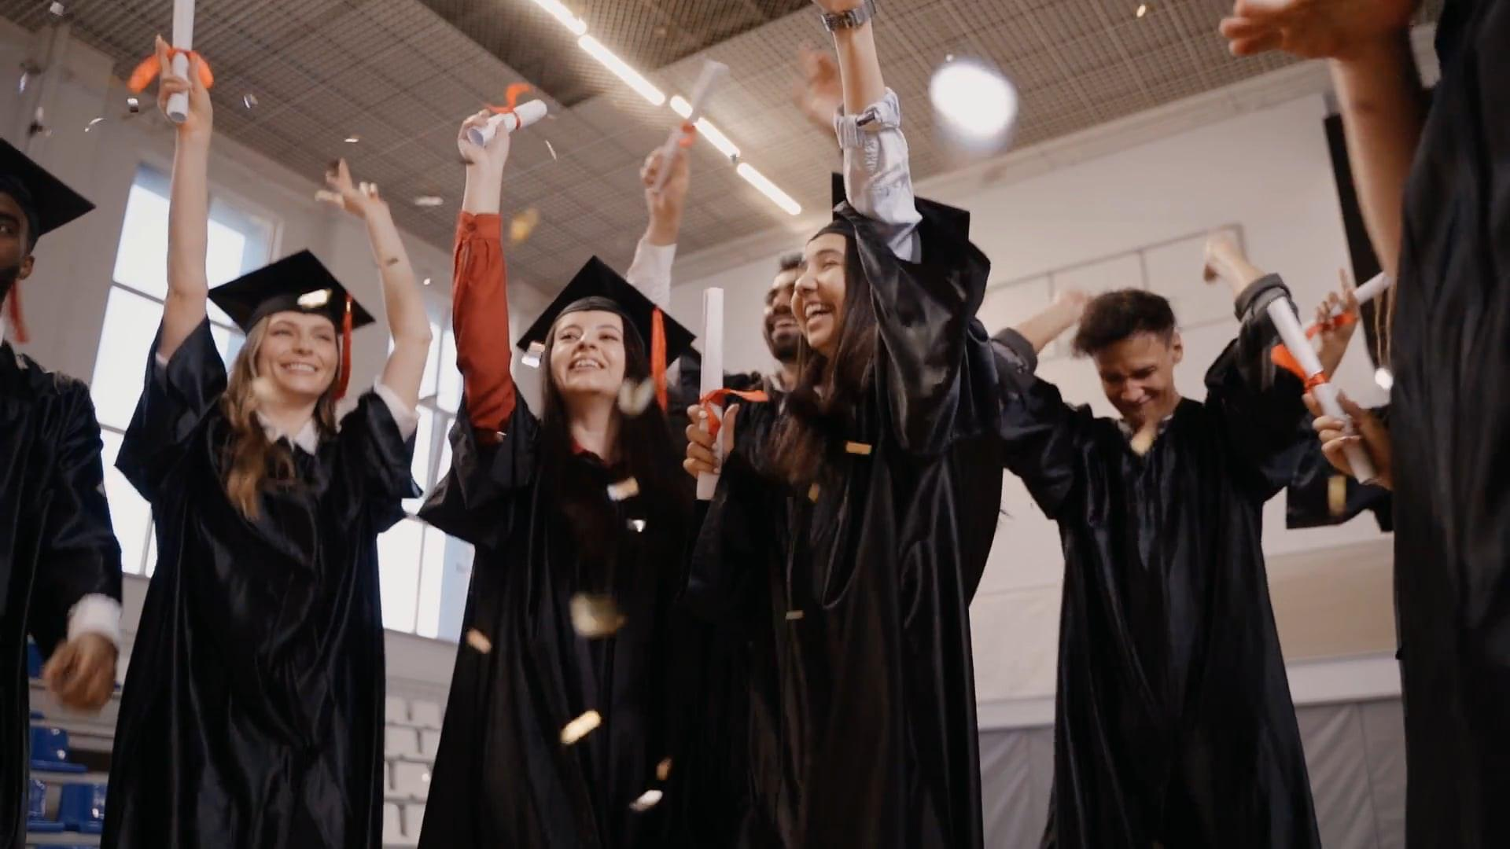
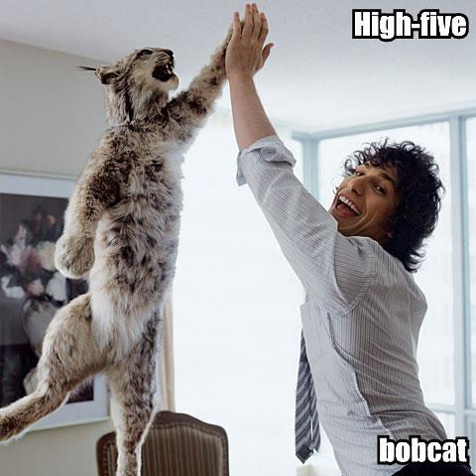
Graduations Day shots!

